Slide 1
Procure to Pay Training
Accounts Payable
Department of Budget & Finance
Brittanie Collier and Sharon Hoff

Slide 2
Going to Cover:
Vendor Search & Verification
Completing a Vendor Maintenance Form
PO, Receipt & Contract Requirements Summary
Verifying your PO Information
PO Buydown Report
Creating a Receipt
Creating Vouchers
Common Voucher Conditions
Invoice Number
Attachments
Processing Credit Invoices
Duplicate Invoice
Double Check
Did you Submit for Approval
Match Exceptions
AOC MD Payment Tab
Liability Offset
Voucher Tips
What to Pay
Prior Balance Research
Voucher Activity Inquiry
Document Status
RIR Notifications
Finding an Existing Voucher
Marking Corrections to a Voucher
How to Recycle a Voucher
Questions

Slide 3
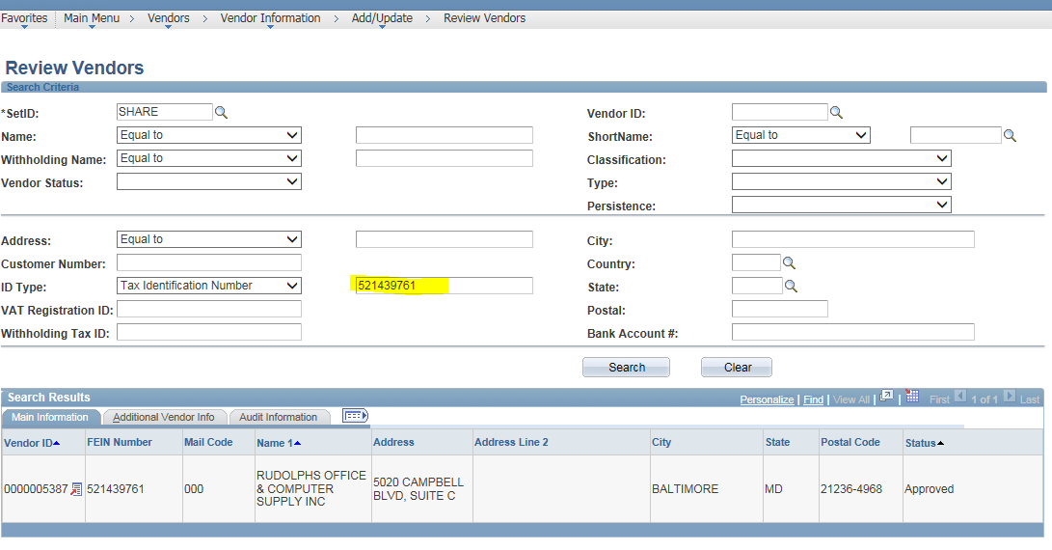
Vendor Search & Verification
Searching for Vendors by FEIN# or SS# is recommended. If the number is unknown, ask the vendor. (SS# will never display in the system.) Example: Rudolph’s Office Supply- FEIN# 52-1439761
Verify that the vendor information in GEARS matches your invoice:
FEIN#
Remit to Address
If the PO is included on the BPO list, you must use the exact vendor ID (number) listed
Complete a Vendor Maintenance form if changes are needed.
Notes:
Mention that SS# for employee’s will not be displayed.

Slide 4
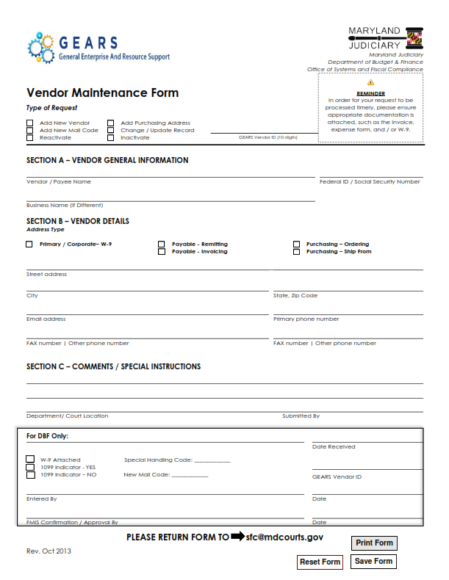
Completing a Vendor Maintenance Form
The form can be found on the GEARS Courtnet site under forms.
Make sure the form is completed in its entirety including:
1. Select a type of request.
2. If updating an existing vendor, enter their
GEARS Vendor ID.
3. Section B- Select an address type.
4. Add any necessary notes to Section C.
Attach a copy of the invoice and/or W-9.
(W-9 is required for a business name change)
Return to- sfc@mdcourts.gov
DBF staff will notify you when the vendor has been updated and approved.
Notes:
Verify your PO is using the same vendor ID number. Before you apply it to the voucher.

Slide 5
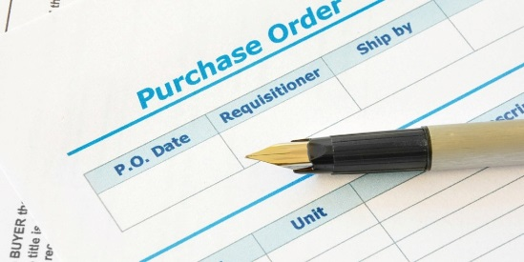
PO, Receipt & Contract Requirements Summary
****District Court requirements may be different.****
Receipts:
Are not required for Express PO’s for purchases $2,500 or less (CC/AOC)
Are required on purchases for goods on PO’s issued by Procurement
Are not required for services
Express Purchase Order’s
Are required for Judiciary Blanket Contracts. Contract numbers must be entered on Express PO’s.
Refer to the Judiciary BPO List for the complete listing.
Are not required for purchases $2,500 or less (CC/AOC)
Requisitions & Purchase Orders issued by Procurement
Are required for purchases over $2,500

Slide 6
Verify PO Information (prior to creating the voucher)
Breadcrumbs: Main Menu> Purchasing>Purchase Orders>Review PO Information>Purchase Orders
Make sure the PO is Dispatched:
A PO cannot be used without being Approved, Budget Checked and Dispatched.
Vendor:
Verify your vendor is correct, by searching the FEIN#, and verify the remit to address.
Line Detail Setup:
Is the PO set up as quantity or amount only as needed?
Is a receipt required?
Receipts are required for goods and are optional for services.
Chart Field:
Verify the account coding is correct based on the goods or services being purchased.
Document Status:
Ensure the PO receipt has not been used previously.
Encumbrance Balance (not year-end encumbrance):
Verify available open balance is correct.
These items are much more difficult to change once a voucher is created and may require additional steps, such as closing the voucher and cancelling the receipt.
Notes:
Pull up an existing PO and show each item.

Slide 7
PO Buydown Report
Main Menu>Purchasing>Purchase Orders>Review PO Information>PO Buydown Report
Breadcrumbs:
Tip Sheet is located on the GEARS courtnet website.
This report allows you to see the activity on a PO, including available line balances and the vouchers & receipts against the PO.
Run this report before vouchering against the PO.
Ensure that the amount needed for the invoice is available on each required line.
Run these reports on a regular basis to check all purchase order balances and activity.
When a PO is complete, run the PO Close request process, which electronically routes the request to Procurement.
Before requesting the PO to be closed, please ensure that all vouchers associated with a PO have been processed by accounts payable and are in “submitted to state” status. This can be done by reviewing the AOC MD Payment tab of the voucher. The status will show “Submitted to State” and a Ref. Document Number will be listed.
Notes:
Have class run report, following tip sheets
Find PO in TRN with multiple lines, Zerox.

Slide 8
Pay close attention to the PO Balance on each line.
Even though the overall PO may have an available balance, the line(s) you are vouchering against has to be able to cover the associated line(s) of the voucher.

Slide 9
Using the Tip Sheets provided,
try creating a:
Receipt
PO Receipt Voucher
PO Voucher
Non-PO Voucher
*All Tip Sheets are located on the GEARS courtnet website and should be
referenced for exact steps during processing.*
Notes:
Create a receipt for PO#2 class created with Robin -Staples
Create a voucher using the receipt just created
Create a voucher using the PO#1 class created with Robin-
Enter and expense voucher use AJ Stationer #5491 as vendor.

Slide 10
Standardization for Judicial expense vouchers: YYYYMMDDII (Date by year (month and day of the earliest day of travel on the form), first and last name initials of the employee as found on the vendor records in capital letters.) Standardization for interpreter invoices: IIMMDDYYHHMM (First and last initials, assignment date by month, day, year and docket time in hours/minutes.) ***For all invoices numbers that involve name initials, where hyphenated or multiple last names are used, the last “last name” is to be utilized in the invoice number. Examples: John Andrews-Sanders, invoice number would utilize the initials JS. Andy Jon De Smith, invoice number would utilize the initials AS. Sherry Bennett Harris, invoice number would utilize the initials SH Standardization for vendor invoices that do not provide a written invoice number: YYYYMMDD (Date of the invoice, followed by the initials of the company name (each word) in capital letters.) Example: An invoice is received and dated March 15, 2018 from Office Supply Network. The user should enter the invoice number as 20180515OSN.
Invoice Number
The invoice number must be keyed in exactly as stated on the original invoice from the vendor.
If an invoice number is not provided by the vendor, the below standardizations should be followed.

Slide 11
Attachments
Make sure all pages are scanned and attached.
All attachments need to be in PDF format. No exceptions.
Unclear images, incorrect images, or no attachments will cause the voucher to be returned for correction and delay the payment processing.
Make sure any required approval emails/letters are attached.
Catering for Special Meetings, Events and Staff Appreciation
Meals must adhere to the approved per diem meal allowance rates.
Per diem rates are inclusive of tips, delivery fees and taxes.
Provide the full list of attendees that food was ordered for.
If seeking reimbursement, vendor’s original receipt must be provided with proof of payment.

Slide 12
Processing Credit Invoices
Enter them the same way you do a charge voucher; just make sure the dollar amount is entered as a negative.
Notes:
When you have a Credit Invoice enter in all the information just like a regular voucher. The only difference is the amount you will key in as a negative.
In the invoice description enter in the invoice # that the credit came from.
Credit Invoice Processing – Credit invoices from vendors that you routinely order from should be entered in the system as vouchers just like other invoices, but as a negative. The credit will be applied to your total account expenditures in your trial balance. However, if you have requested a REFUND from the vendor for a credit invoice, then this invoice should NOT be entered into the system. You should hold the credit invoice at your location until you receive the check and then mail the invoice and the check to DBF Revenue for processing. Once the refund is received, a credit will be applied to your trial balance expenditures.
Enter a credit invoice Vendor #5387

Slide 13
Duplicate Invoice
When entering your invoices, you might get a Warning:
e.g. “Warning-Duplicate invoice detected. See voucher 0017931 for Business Unit MDJUD. Voucher can be saved and posted.” Please verify whether or not this is a duplicate voucher.
If after your review of the previous voucher cited, you determine that the current voucher is a duplicate, and you have not saved the voucher, then you should select cancel. This will put you back into your current voucher page. From here, you should navigate to home. The system will then provide a second message stating that you have unsaved data. You should select cancel. The system will exit from your current voucher without saving the document or creating a new voucher number.
If after review of the previous voucher cited, you determine that the current voucher is a duplicate, and you have saved the voucher, you can re-use (recycle) this voucher for another invoice. Make all necessary changes to match the new invoice that you are going to process, i.e. Vendor #, PCA, Amount, Invoice Date and Number, and attachment. Do not forward the invoice for approval until you have changed the voucher to the information on your new invoice.
Notes:
This is where the invoice number comes in to play. When the system detects a duplicate invoice number with the same vendor you will receive this warning. That is why it is important to make sure your invoice number is entered exactly how it is on the invoice.
When you Receive this Warning you need to STOP and research verifying that it is or is not a Duplicate Voucher.
If it is you can do re-use the Voucher ID # or you can not save it if you haven’t already.
Enter a 2nd invoice for AJ Stationer. Vendor #5491, Invoice #1234, Invoice Date #10/30, $500
Show how to:
-Open new window and pull up existing voucher
-Verify that it is a duplicate
-Exit out of the voucher creating with out saving

Slide 14
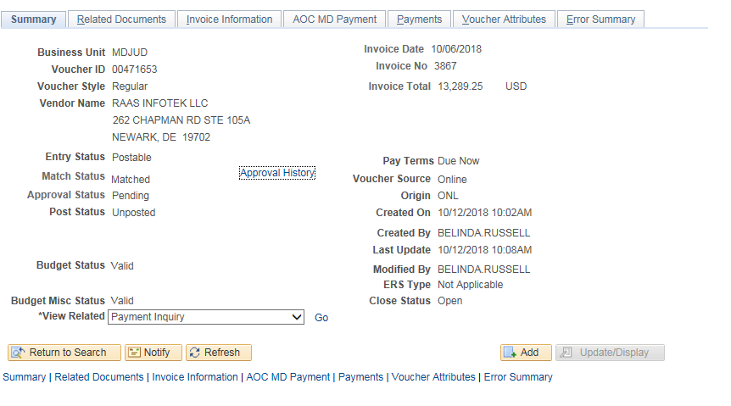
Double Check your Voucher
The circled sections should be verified.
Voucher statuses if completed correctly:
Match Status:
No Match-non PO voucher
Matched-PO voucher
Approval Status:
Pending-Submitted for Approval
Approved-Approval is complete
Budget Status, Budget Misc Status
All Valid

Slide 15
Double check your Voucher
Incorrect statuses for a voucher that indicate further action is required:
Match Status:
Ready-Matching has not been run
Exceptions-PO is not matched successfully to the voucher
Approval Status:
Not Submitted-Has not been submitted for approval
Denied-Approval was denied
Budget Status, Budget Misc Status
Not Checked-Budget checking has not been run
Error-Budget error has occurred

Slide 16
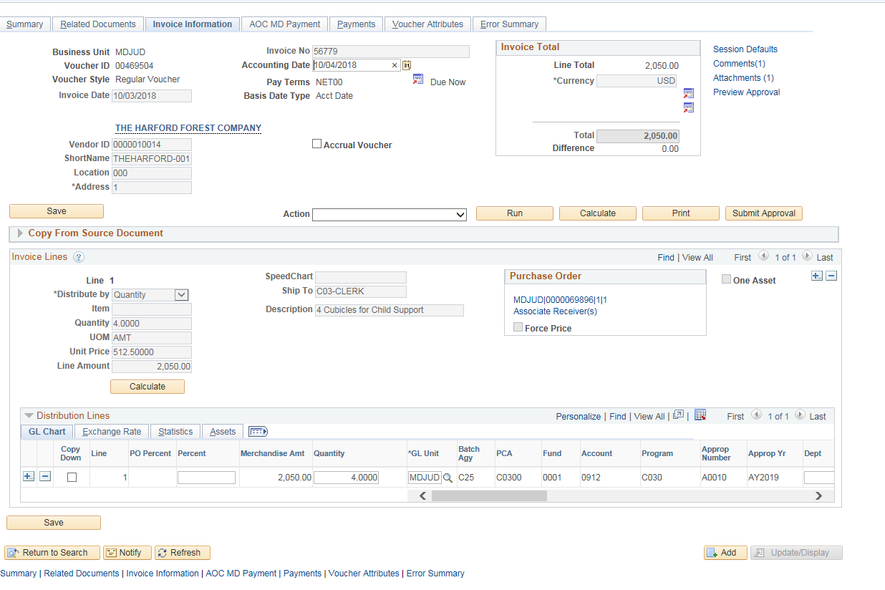
Did you Submit for Approval:
Verify that you have submitted the voucher for approval. This button will only display after a successful budget status has been reached.

Slide 17
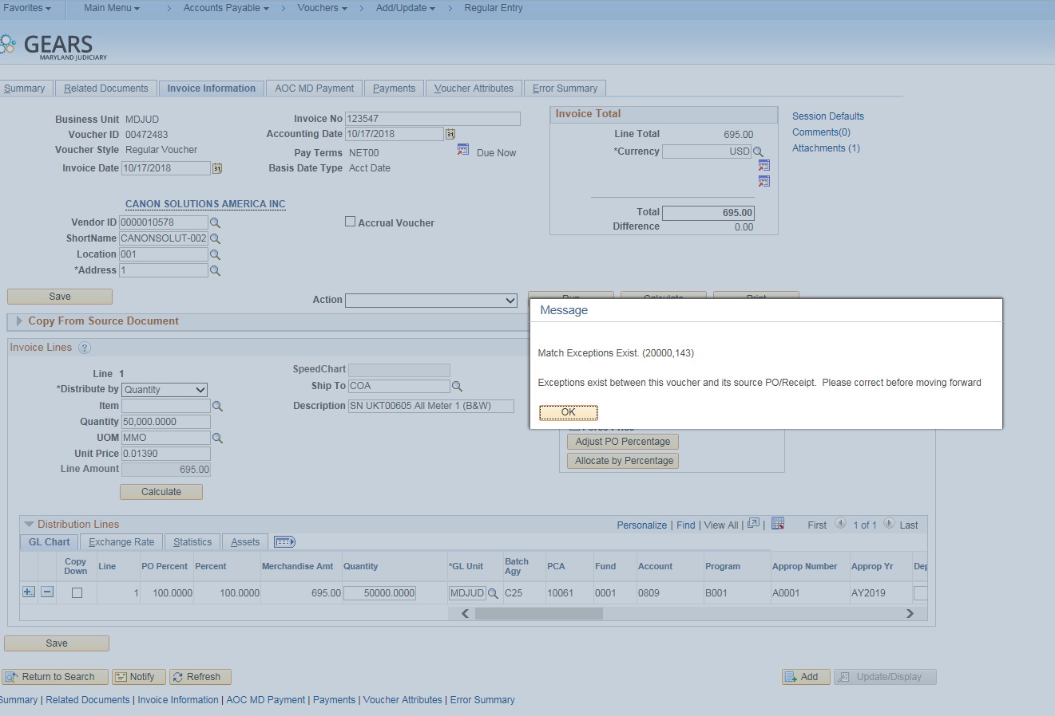
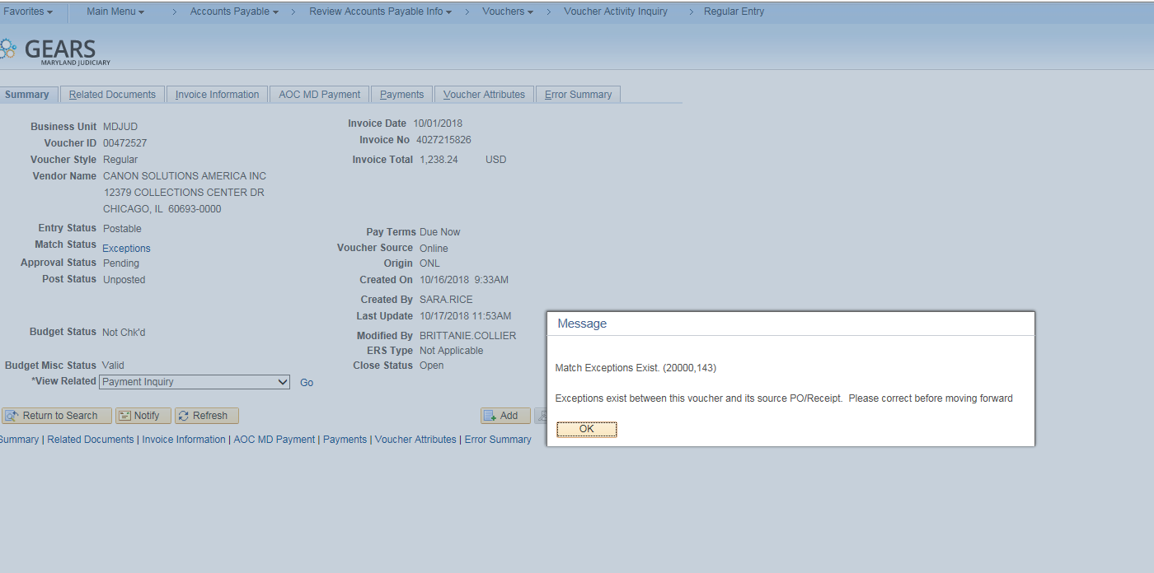
Match Exception Warnings
Exceptions give warnings when they are received.
As well as when the voucher is reopened.

Slide 18
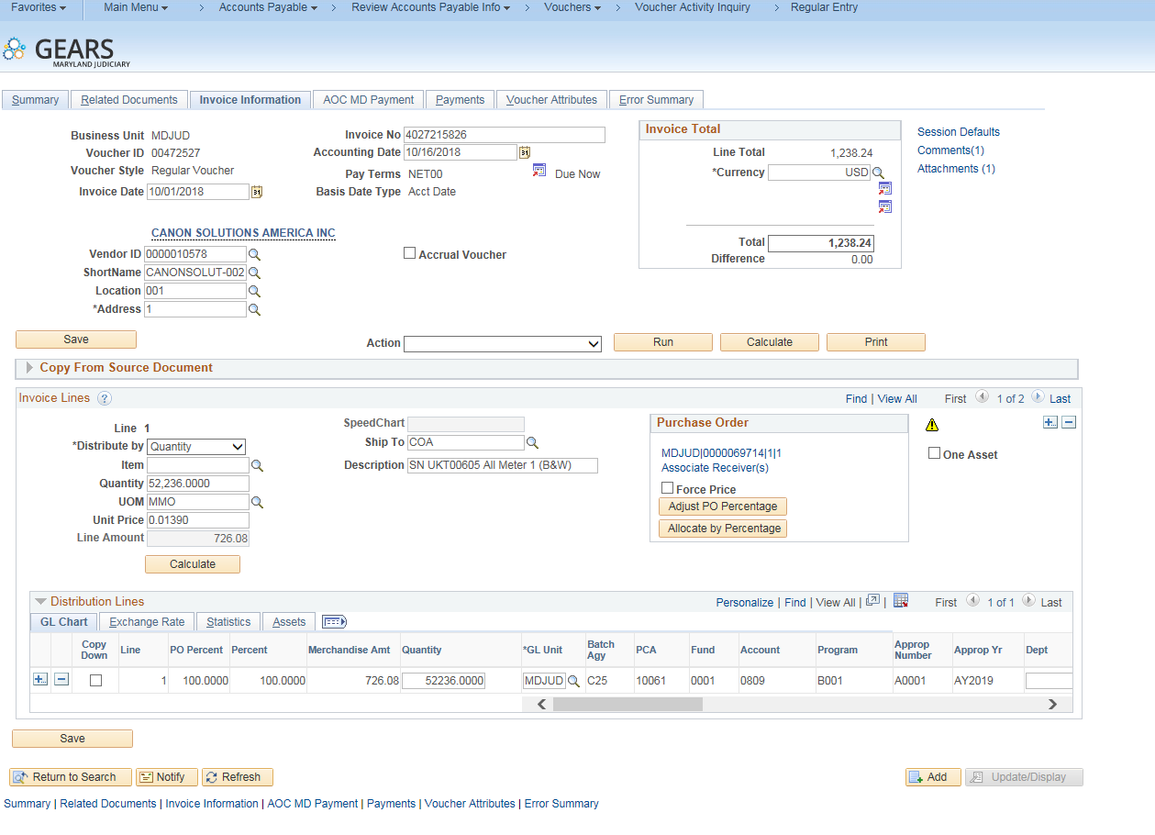
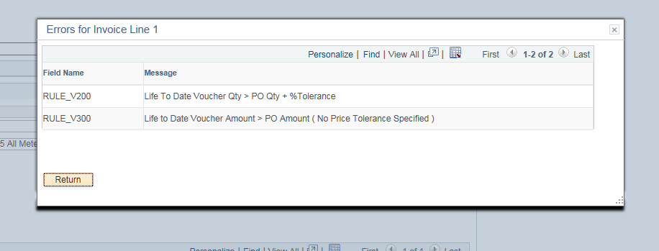
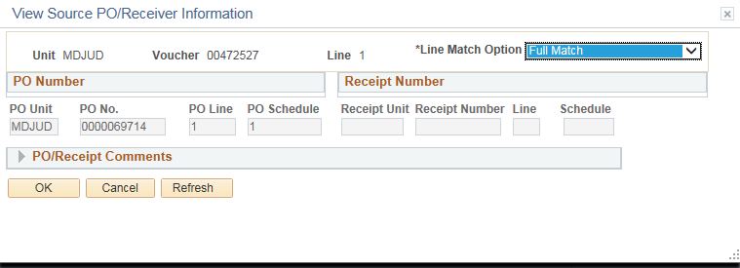
Identifying Match Exceptions
The Errors box shows the type of Match Exception Received
The View Source PO/Receiver Information shows the PO number and line number, this invoice line is associated with.

Slide 19
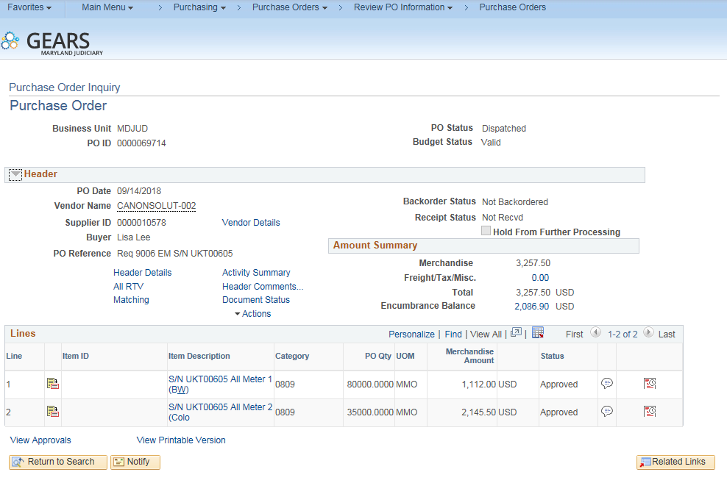
Researching Match Exceptions
Where to look:
Open PO using PO Inquiry
Check PO status, should be dispatched.
Check encumbrance balance on PO Inquiry page.
-Ensure balance covers the invoice you are paying.
If the invoice is less than the PO amount for a service, ensure the PO line is marked amount only.

Slide 20
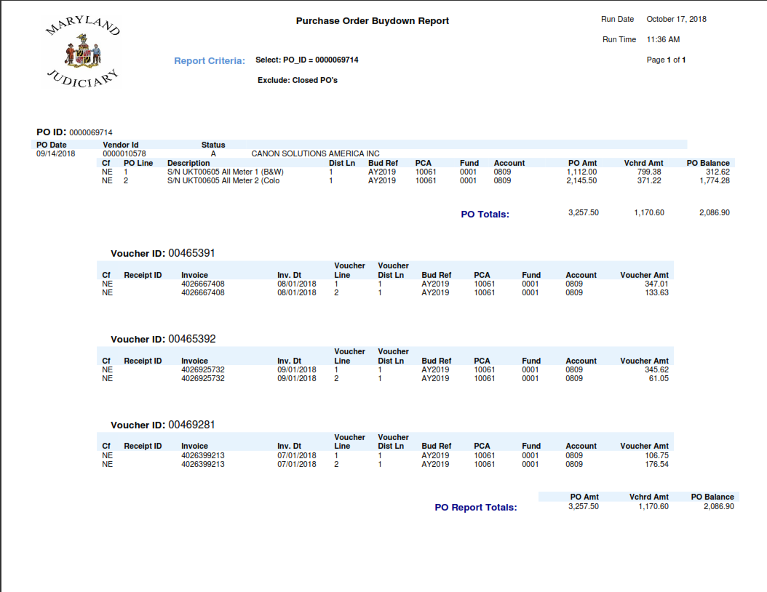
Researching Match Exceptions
Where to look:
Run a PO Buydown Report
Check line available balances for the matching PO line from the voucher.
For this example, PO line 1 has $312.62 available. The invoice line to be paid from the voucher is for $726.00. So, the PO will need to be increased in order to process this voucher.

Slide 21
Correcting Match Exceptions
Error: PO not in Dispatched Status
Solution: Contact the buyer listed at Procurement to dispatch the PO.
Error: PO Encumbrance balance does not have enough money to pay invoice
Solution: Contact the buyer listed at Procurement to increase the PO. Supporting documentation will need to be provided, (i.e. invoice, contract, etc.)
Error: PO line is not marked amount only
Solution: Contact Brittanie Collier, to disassociate PO from voucher. The buyer can then make corrections to the PO.
Error: PO line balance does not have enough money to pay invoice.
Solution: Contact the buyer listed at Procurement to increase the PO. Supporting documentation will need to be provided, (i.e. invoice, contract, etc.).
Note: There are times that vouchers for copies will result in a match exception, where all items appear to be correct. The match exception can be caused by rounding of the copy prices.
If there this situation occurs or additional assistance is needed
please contact Accounts Payable or Brittanie Collier.

Slide 22
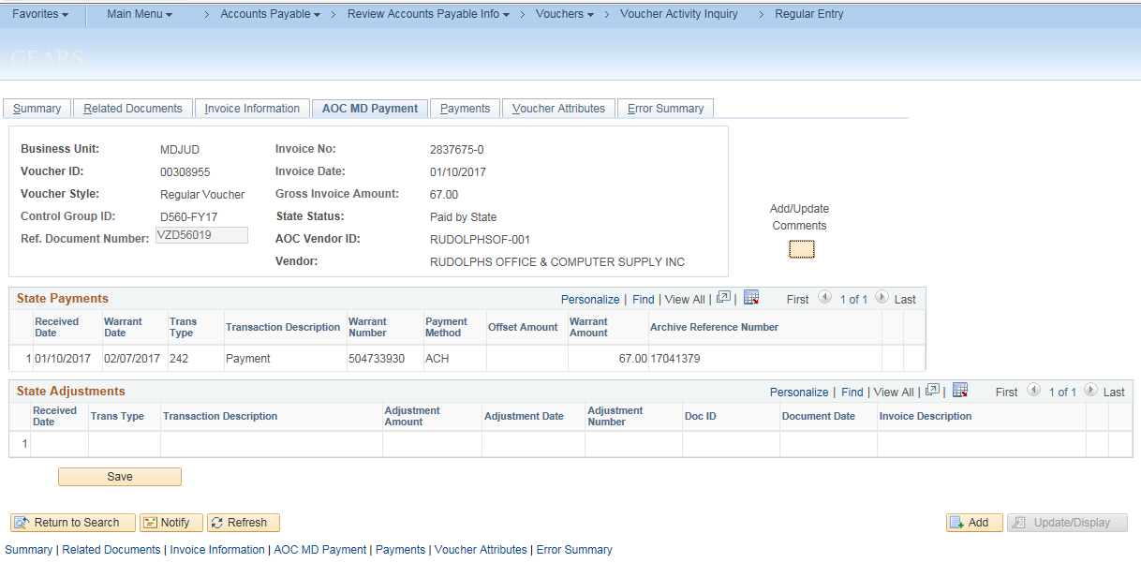
Payment Information
The highlighted section shows the payment information as processed by GAD to the vendor.
Payment Method Types:
ACH- Electronic payment to the vendors bank account.
(To setup ACH payments, the Vendor must contact The Comptrollers Office.)
CHK- Check payment mailed to the vendor.
Notes:
This Tab shows the Reference Dock number & Archive Reference number (assigned by GAD).
It references the payment date and payment method.

Slide 23
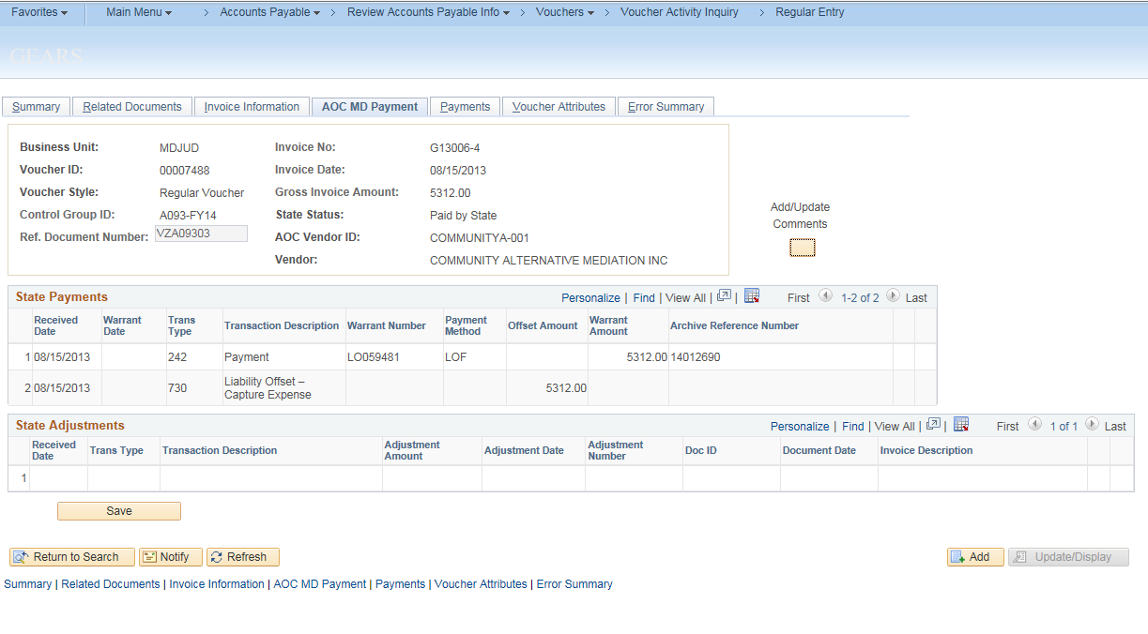
Liability Offset
The highlighted section shows that Liability Offset has captured the payment due to an outstanding balance the vendor owes the state. The vendor will receive notification with information on where to call if they have questions. This notification can also be found in the attachments section of the voucher.
The Judiciary’s debt to the vendor has been satisfied and nothing further needs to be done.
Notes:
When Liability Offset has capture the payment, it will show as Liability Offset (LO) with the LO or LOA number.
The Liability Offset notice will have been scanned and attached. You are able to print out the letter and provide a copy or answer questions from the vender.

Slide 24
Voucher (Invoice) Tips
Remember to attach your invoice. Voucher cannot be saved without attachment.
Ensure the invoice number and invoice date agree with the invoice.
Use the description field to record important information, such as serial numbers that will help identify the expense. Enter these items on your requisition, so the information is also pulled into the PO & voucher.
Make sure the description does not have any special characters, such as `: \ ’ /. Many of these are copied over from the Requisition and/or PO descriptions. If these are present, the system will issue a warning and will not save the voucher until the characters have been removed.

Slide 25
Phone bills are entered at DBF and do not require local approval. The invoices are attached to the voucher. You may locate these vouchers through the voucher activity inquiry or by running GL reports.
Budget Check Warnings Exist-
No action is required by the user.
Budget Check Errors-
Please check the budget exception page to view the error details. If you need assistance, please call the DBF, Budget Unit.
Make sure all statuses are Valid and that the Voucher is approved.
Follow the Travel Policy- For more information, please visit the travel website on Courtnet or register for the GEARS Travel Class.
When a vendor does not provide an invoice number the following standardization should be used:
YYYYMMDDII (Date by year, month and day, initials of the company (each word) as found in the vendor record in capital letters)
For expense reimbursement vouchers, the invoice standardization is as follows:
YYYYMMDDII (Date by year (month and day of the earliest day of travel on the form), first and last name initials of the employee as found on the vendor records in capital letters.)

Slide 26
What to pay:
Pay Current Activity - A voucher should represent only the current activity/balance displayed on the supporting invoice. All past due balances on invoices must be reviewed to determine if they have already been processed for payment or if further action is required. Sometimes, calls to the vendor are required to obtain copies of missing invoices.
Remove sales tax & late fees from invoices, note this on the invoice before scanning, and notify the vendor so they can adjust your account.
Before scanning these invoices, make the necessary notes and/or corrections on the invoice, then attach it to the voucher.

Slide 27
Prior Balance Research
Pay Current Activity- A voucher should represent only the current activity/balance displayed on the supporting invoice.
All past due balances on invoices must be reviewed to determine if they have already been processed for payment or if further action is required.
Any missing payments cannot be made based on a past due balance. Contact the vendor to obtain copies of any missing invoices and process them separately.

Slide 28
Search Options:
Using Voucher Activity Inquiry, enter the vendor ID, PCA and Approp year or accounting date range.
If you use the voucher description* to put identifying information that can be used to search as well.
*Suggested to use this field to enter equipment serial numbers or account numbers.

Slide 29
Voucher Activity Inquiries
Breadcrumbs: Accounts Payable>Review Accounts Payable Information>Vouchers>Voucher Activity Inquiry
Run inquiries following the Tip Sheet provided and the Recommendations document.
The inquiry page will allow you to search the following criteria: Voucher ID #, PO #, PCA, Entered By, Budget Status, Approval Status, Match Status, Invoice Description, etc.
Check this inquiry page on a regular basis to ensure all vouchers are moving forward in the payment process.
Notes:
Have class run report, following tip sheets
Deleted vouchers are done before it has been fully processed to GAD and has not had any payments completed
Closed vouchers are vouchers that have had something incorrect that required the voucher to be closed. Example the PO was not correct, the payment had to be canceled, etc.
Show all different statuses.
-Not Submitted/In the field- show match exceptions, budget error and approval
-DBF in Process-Shouldn’t make any changes to voucher with out calling AP first.
-DBF Hold-Create a voucher in TRN and place in Hold to show.
-Submitted to State-show GEARS payment number but now warrant number
-Paid by state-Show warrant number

Slide 30
Voucher Activity Inquiry Example

Slide 31
Voucher Activity-Statuses
Not Submitted / In the field – If the voucher does not meet the criteria for being moved into the DBF queue, it would show this status. i.e., not submitted for approval, not budget checked.
DBF in Process – The voucher has been placed in a Control Group for payment. The control group can be found on the AOC MD payment tab of regular entry, Control Group ID.
DBF Processing Hold –This status would capture those vouchers that are in one of the DBF special hold control groups.
Submitted to State – The voucher has been submitted to the state for payment via our daily electronic file, as evidenced by the population of the ref document number. This information is found on the AOC MD Payment tab of the regular entry.
Paid by State – The voucher has payment information from the state in the AOC MD payment tab of regular entry.
Cancelled Payment – The voucher went through the payment selection process but subsequently, the payment was cancelled.
Closed – The voucher was posted and then subsequently closed.

Slide 32
RIR Notifications
Workflow Notifications:
Accounts Payable has identified that a correction is required before the voucher can be processed.
Once you have revised the voucher, please reply to the RIR (with history) to: DBF Accounts Payable, so processing can continue in a timely manner.
Notes:
User may receive a phone call before receiving this notice. If AP can not get a hold of the user they will send an RIR notice.
Do not create a new voucher, show how to find an existing voucher, using Tip sheet.

Slide 33
Finding an Existing Voucher
Breadcrumbs: Main Menu>Accounts Payable>Vouchers>Add/Update>Regular Entry

Slide 34
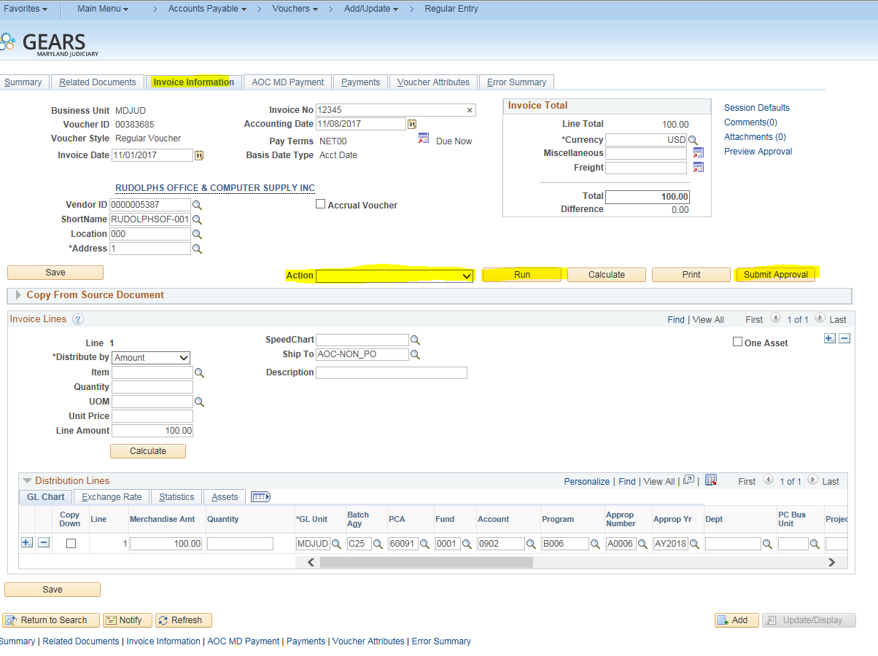
Making Corrections & Resubmitting a Voucher
On the Invoice Information Tab, make any and all necessary changes to the voucher.
Once complete, re-run budget checking, and matching if needed.
Re-submit for approval.
Same process for using a “recycled” voucher.

Slide 35
How to Recycle a Voucher
If you have entered a voucher by mistake or if it is no longer needed, it is possible the voucher can be recycled. In order to recycle a voucher, it must have statuses of unapproved and not submitted. If the voucher is in DBF in Process Status, please contact Accounts Payable before recycling.
Follow the below steps to recycle the voucher, next time you have an invoice to process.
Find the existing voucher, enter the voucher number that is being recycled.
Go to the Invoice Information Tab and change all required information, i.e. Vendor, Amount, Invoice Number, Attachment.
Run Budget Checking and/or Matching.
Submit tor Approval.

Slide 36
Any Questions?
Please feel free to Contact Us:
Brittanie Collier
Unit Director
410-260-1379
Sharon Hoff
Supervisor
410-260-1412
Trudy Brown
Lead Worker
410-260-1378

