Slide 1




Order To Cash Training
Department of Budget & Finance
Suzie Bishop & Brittanie Collier

Slide 2
Agenda
      Chatfield's & SpeedCharts
      Chargecodes
      Cash Register Not Reset or Z’d Out
      Adjustments
        Post FAR
        P&P and CCU Adjustments - Returning funds
        COSA Fee Adjustments
        District Court Only - Adjusting Funds Received
      Revenue Refunds
        Review Vendors
        Voucher & Bill Entry
      Revenue Reports
        Important Reports & Queries
        Trial Balance
        Detail Trial Balance
        Revenue Detail Activity Report
      Reconciling Clearing Accounts
        Ledger Activity
      Voucher Activity Inquiry
      End of Month Overview
        EOM Local Revenue Disbursement Flowchart
        Processing Checklist
        EOM Local Revenue Disbursement Tips
        Closing Periods
        Process EOM
      How to Schedule a Query
      Open Forum & Questions

Slide 3

Understanding Chartfields in GEARS
The Judiciary’s full chartfield stream consists of 7 fields of information, which when combined define the proper allocation of transactions within general ledger, budgeting and revenue recording.
All fields of the Chartfields are required to define and validate funding.

Slide 4
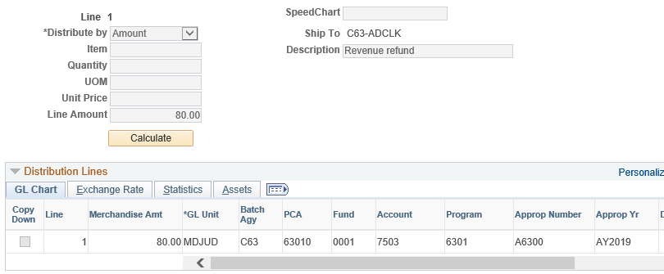
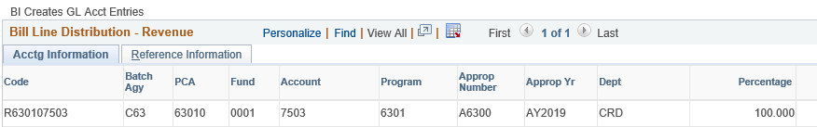
What is a SpeedChart?
A SpeedChart code is used to automatically populate 5 of the 7 fields that make up the Chartfield string. The register code is used similar to a Speedchart, enter the register code and all fields will populate except for Dept.
  Increases data efficiency by reducing the number of keystrokes.
Enter your Program Cost Account (PCA) in the SpeedChart field and the system will auto populate Batch Agency, Fund, Program, Appropriation Number, and PCA.
In most cases, you will need to enter the two other fields, account and Appropriation Year.
Enter the Appropriation Year (year is based on the ending period of the current fiscal year, i.e. AY2019, unless the revenue was accrued).

Slide 5
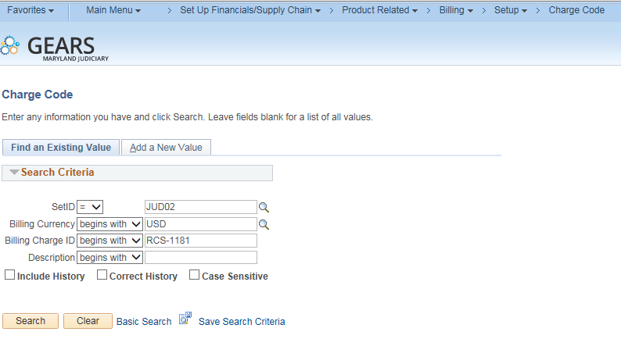
Chargecodes
How To Look-up a Charge Code
This step is listed to help familiarize you with how to locate the Revenue Allocation for a specific charge code.
NAVIGATION: Main Menu > Set Up Financials/Supply Chain > Product Related > Billing Setup > Charge Code
The charge code search criteria page will display.
a. SetID: Enter JUDxx for your batch county
b. Billing Charge ID: Enter the full charge code id or a portion.
c. Description: change to contains: Enter a portion of the charge code description
d. Select the appropriate charge code link.

Slide 6
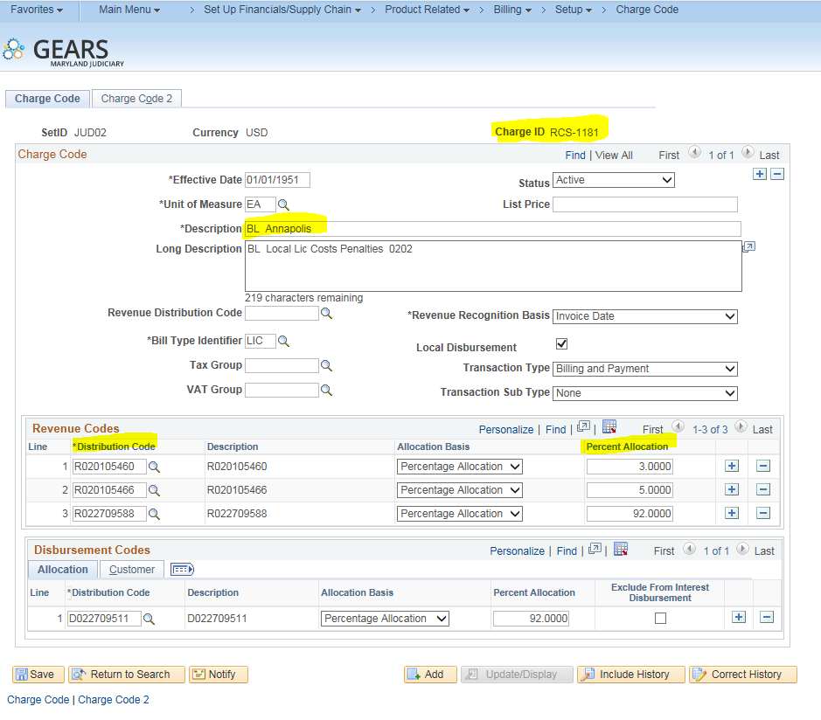
Chargecodes-continued
The charge code page will display once you select a charge code.
In the example below: RCS-1181 for JUD02 has 3 Revenue Distribution codes. Each one of these codes will need to be added to the Acctg – Rev Distribution page to accurately complete the allocation for this charge code.

Slide 7
Cash Register Reset or Z’d Out
Occasionally, there may be an instance when a cash register was not Reset or Z’d Out on the day in which the funds were received.
The below instructions are to be used if one or more of the registers was NOT Reset or Z’d-OUT from the previous evening.
As always, please contact Service Now should you have any questions or issues.
RCS/UCS:
If the deposit has not been sent to the bank, the recommendation is to include both day’s work (previous day and current day) in the Z-Out for the current day and have just one deposit ticket for both day’s work.
If the deposit was sent to the bank, then perform the Reset for RCS, or the X-Out and then Z-Out process for UCS for the missed day’s work. This will mark the previous day’s work with the current date as the z-date.
  Registers can continue to be used for current day’s activity without any impact.
  Go to JIS Bus – confirm the previous day’s totals are correct. Submit data to GEARS.
  Go to GEARS – following the GEARS Daily Deposit instructions, enter the Treasury Code 6 digit Deposit Number in both rows, (row with yesterday’s date and the row with today’s date) and complete all queries, reports, and processes.

Slide 8
Cash Register Reset or Z’d Out continue
    However if:
  You have already completed the previous day’s work in GEARS except for this register, then you will need to add a different Treasury Code (Deposit Ticket number) in GEARS. Use the next one in your stack with a note that this was used for Register XXX not Reset until the morning of xx/xx/20xx. Complete all queries, reports and processes.
  Send an email to Suzie Bishop and Vesta Davis informing them of the error, so they are aware of it and can inform GAD.
    Include the following information in your email to DBF:
    Treasury Code (deposit id)
    Actual Date Deposit was sent to the bank
    Deposit Amount
    Z-Date. (the z-date will be the date the RESET or Z-OUT occurred)
    CCS: (Stand-alone registers Circuit Courts)
    CCS disks are created one at a time. Each Z-Out creates a disk with a text file.
    Modify the date to the correct Z-Out date and load the disk to the JIS Bus.
    Go to JIS Bus – confirm the previous day’s totals are correct. Submit data to GEARS.
    Go to GEARS – following the GEARS Daily Deposit instructions, complete all queries, reports and processes.
    Exception: if the Z-Out date was not modified, please enter a Service Now ticket.

Slide 9
Adjustment Types
JDP (Adjustment Deposit)-To reduce or increase revenue for cash or check payments only as a post-Z adjustment, when a chargeback is expected from the bank.
JAD (Adjustment Other)-To move the revenue from one charge code to another as a post-Z adjustment.
JCR (Adjustment Credit Card)-To adjust the credit card deposit after the FAR Report has been completed.
JCU (Adjustment CCU)-To adjust the CCU deposit after the FAR Report has been completed.
JPP (Adjustment P&P)- To adjust the P&P deposit after the FAR Report has been completed.
JBC (Adjustment Bad Check)-To reduce revenue collected for a returned check that was received.
JER (Adjustment E-Recording)- To allocate E-Recording Payments.
JEC (Adjustment Echecks)- To adjust an electronic check after the FAR report has been completed. Note: Echecks and Credit Cards will be on the same FAR report.

Slide 10
Adjustments-Post FAR
  Occasionally, there may be an instance when the Funds Allocation Report did not accurately reflect the deposit amount or allocation, and was not caught prior to running the Single Action Invoice process. Making a correction for this is referred to as a Post Far Adjustment. There are 2 basic types of Post FAR Adjustments that may be needed. The format of the bill lines will determine the type of adjustment made.
  Use Scenario 1 - JDP (Adjustment Deposit): To adjust the Deposit Revenue amount as a Post-Z Adjustment. (Either reduce or increase the revenue for cash or check payments only).
  Use Scenario 2 - JAD (Adjustment Other):
    To move the revenue from one charge code to another charge code as a Post-Z adjustment,
    To make an amount correction for a credit card or STARS payment method.

Slide 11
Adjustments-Returning Funds to P&P
Complete the Journal Adjustment Form
  Examples are provided
Email the form to the Revenue email below.
  Judiciary Finance Revenue Circuit Court - jfrcs@mdcourts.gov
  Judiciary Finance Revenue District Court - judfinrevdc@mdcourts.gov
  Devra Moulton -DPSCS- devra.moulton@maryland.gov

Slide 12
Adjustments-Returning Funds to CCU
Complete the Journal Adjustment Form
  Examples are provided
Email the form to the Revenue email below.
  Judiciary Finance Revenue Circuit Court - - jfrcs@mdcourts.gov
  Judiciary Finance Revenue District Court - judfinrevdc@mdcourts.gov

Slide 13
        Adjustments-COSA Fees
Complete the Journal Adjustment Form
  Examples are provided
Email the form to the Revenue email below.
  Judiciary Finance Revenue Circuit Court - jfrcs@mdcourts.gov
  Judiciary Finance Revenue District Court - judfinrevdc@mdcourts.gov

Slide 14
Revenue Refund Process
Revenue refunds are required when an overpayment is received and a refund check needs to be issued. This is a 2-part process. Please be sure both parts are completed.
Part 1. Enter a new voucher in Accounts Payable to send a check to the vendor.
Part 2. Enter an adjustment bill in billing to capture the charge code of the refund, so that the EOM Local Revenue process will be adjusted accordingly. (District Court locations need to process this adjustment ONLY if the refund is for a Local Revenue item.)
Note: Verify that you are using the correct PCA codes. Revenue PCA’s are all numeric (ex. 01010).

Slide 15
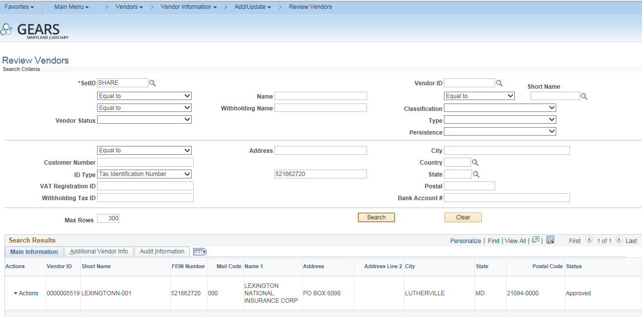
Vendor Search & Verification
Searching for Vendor by FEIN# or SS# is recommended.
Example: Lexington National Insurance: 52-1662720
Verify that the vendor information in GEARS matches your invoice:
  FEIN#
  Remit to Address
  Complete a Vendor Maintenance form if changes are needed.
Notes:
Mention that SS# for employee’s will not be displayed.
Talk about how vendors are required to provide their FEIN to the state. So user can call and ask for it if needed.
Run search in GEARS with Pitney Bowes and Best Buy

Slide 16
OTC Important Reports & Queries
No. | Used When? | Report/Query Name | Description | Navigation
1 | Daily Bus | Fund Allocation Report | Summary report by PCA and Account, of the revenue deposit transactions for a specific Treasury Code (deposit ticket #) and Z-Date. This report is for Cash and Checks only. Should match the actual deposit sent to the bank for a given date. | Main Menu > Billing > Interface Transactions > AOC All Fund Allocation Rpts
2 | Daily Bus | AOC_CHARGE_ID_ALLOCATIONS | List of all cash and check bills. Can be run daily, monthly for all accounts or an individual account. | Query Viewer
3 | As Needed | AOC_AP_REV_REFUNDS | List of Vouchers entered for Revenue Refunds. Displays vendor, date paid, and state check number once issued. | Query Viewer
4 | Local Rev EOM | AOC_LOCAL_REVENUE_DISBURSEMENT | List of Local Revenue Bills and Vouchers disbursed for a given month. | Query Viewer
5 | Local Rev EOM | Disbursement Transmittal Summary | Listing of bills to be disbursed to Local Agencies | Maryland Judiciary>Reports>Disbursement Reports
6 | Local Rev EOM | AOC_CHARGE_ID_ALLOC_EOM | List of all bills and all payment methods for all bill types, that have a charge code on the bill that should be distributed to a local agency. Intended to be run monthly to balance your LRV, Local Revenue Disbursement Bill. | Query Viewer
7 | Research | AOC_BILL_ADJUSTMENTS | Report of all bills with a bill type other than BUS. (i.e. JAD,JBC, etc) by date range | Query Viewer
8 | Research | AOC_CHARGE_ID_ALLOC_1CODE_EOM | List of transactions for a range of dates or one date for one charge code for all bill types including adjustments. | Query Viewer
9 | Research | AOC_CHARGE_ID_LIST_WDISBURSMNT | List of all charge codes and applicable disbursement information available to your court. | Query Viewer
10 | Research | AOC_CHARGE_ID_LISTING | List of all charge codes available to your court. | Main Menu > Reporting Tools > Query > Query Viewer > AOC_CHARGE_ID_LISTING
11 | Research | AOC_CHARGE_ID_ALLOC_BY_ACCT | Charge Items all by account number | Main Menu > Reporting Tools > Query > Query Viewer > AOC_CHARGE_ID_ALLOC_BY_ACCT

Slide 17
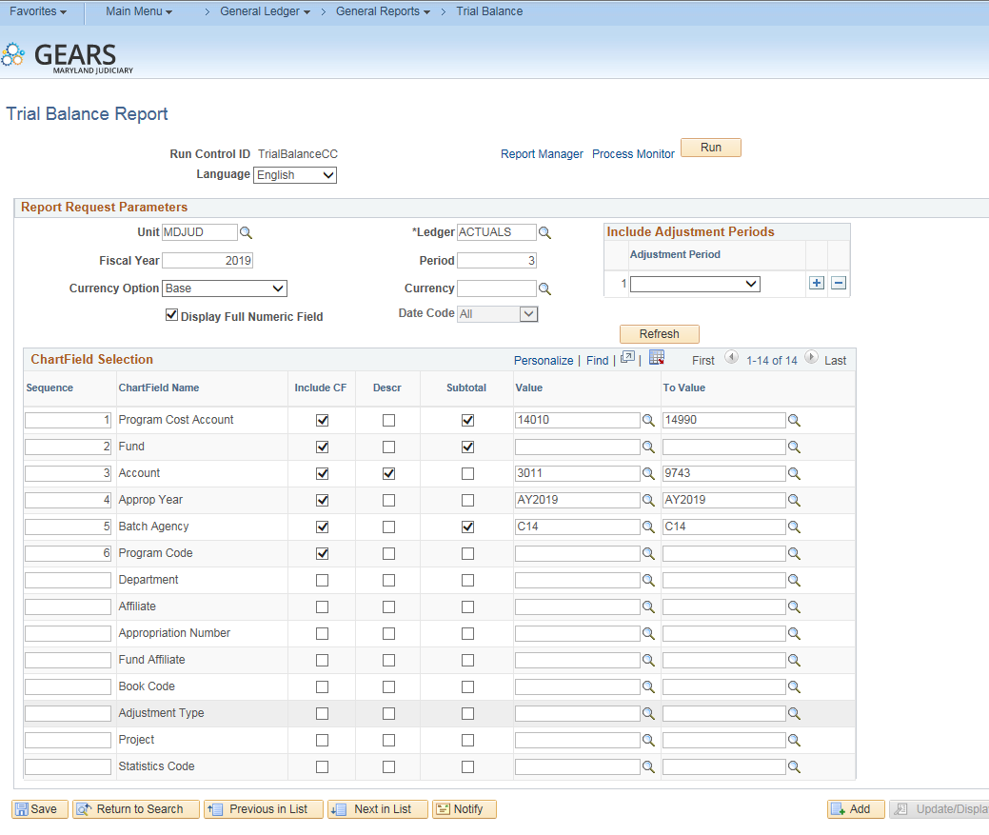
Trial Balance Report
Main Menu>General Ledger>General Reports>Trial Balance

Slide 18
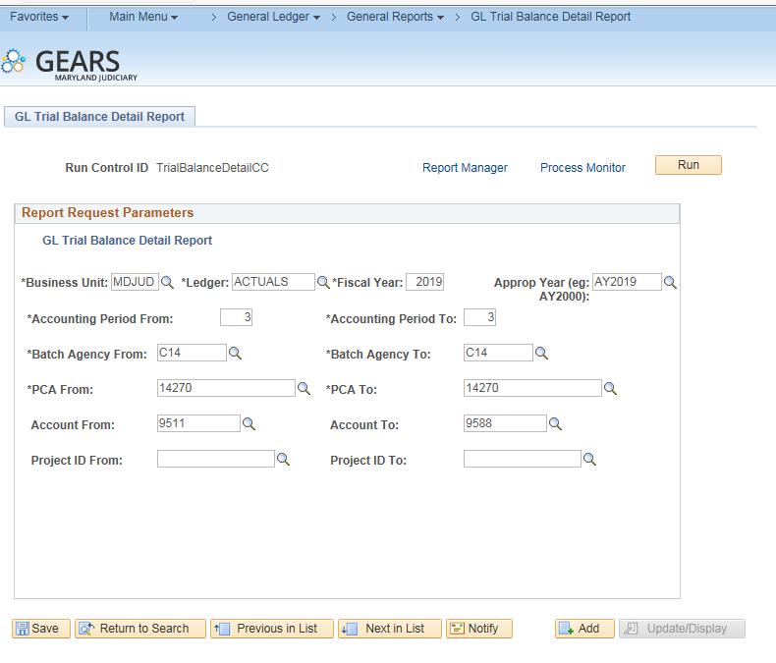
Detail Trial Balance Report
Main Menu>General Ledger>General Reports>
GL Trial Balance Detail Report

Slide 19
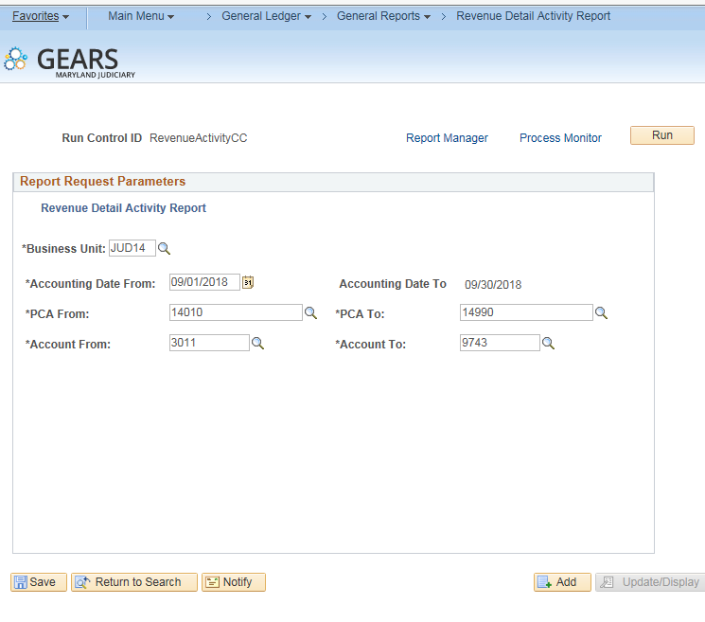
Revenue Detail Activity Report
Main Menu>General Ledger>General Reports>Revenue Detail Activity Report

Slide 20
Reconciling Clearing Accounts
All clearing accounts should be reconciled monthly. This includes CCU, P&P, Chargeback and Judgment Liens. If there are any remaining balances, they should be easily identified and accounted for. At the end of the fiscal year, all clearing accounts must net to zero. Accruals at year-end may be necessary for account balances, but only with proper supporting documentation.
So what report should you use?
We recommend using the Ledger Activity Report. This report will show you both receipt and allocation accounts.
Helpful hints: When reconciling judgment liens, if the journal ID begins with ‘000’ the entry was posted by DBF. If you open the journal and click on the attachment, the supporting documentation can be viewed.

Slide 21
Reconciling Clearing Accounts
General Ledger Activity Set up
How to run the General Ledger Activity Report?
  Navigation: Main Menu > General Ledger > General Report > Ledger Activity
  Enter the criteria below:
  General Ledger Run Control ID, create a new one.
    Name examples: LAP&P or LACCU
  Select a Leger - Actuals
  Enter Fiscal Year - 2019
  Enter a Period From: 1 To: 12
  Select the checkbox - Show Journal Detail
  Click the Refresh button to show Chartfield Selection Screen

Slide 22
Reconciling Clearing Accounts
General Ledger Activity Set up Continued
  Sequence – The order in which the information will appear on the report. Batch Agency, PCA, Account and Fiscal Year
  Click the select box that corresponds to the chartfield to display on the report. For Batch Agency, PCA and Account, check the following boxes: Include CF, Summarize, and Detail. For Appropriation Year, check only the include CF box.
  Value: (replacing XX with JUD Number/Batch Agency)
    Batch Agency CXX
    Central Collections (CCU) PCA XX010 Account 5467 to 5468
    Parole and Probation (P&P) PCA XX240 Account 9651 to 9653
    Chargeback Clearing PCA XX990 Account 9651 to 9652
    Judgment Lien PCA XX290 Account 9654 to 9654
    Fiscal Year
    Click Save

Slide 23
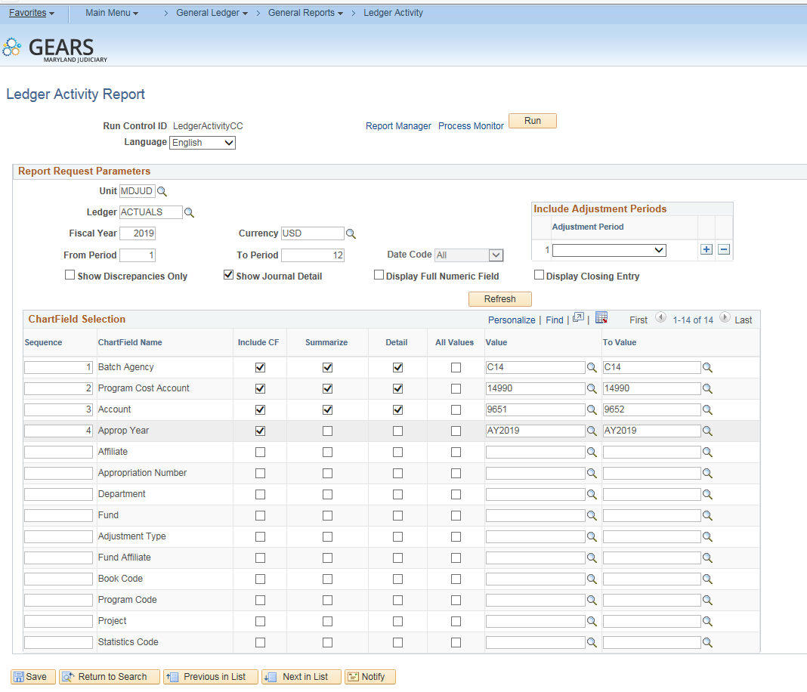
Ledger Activity Report
Main Menu>General Ledger>General Reports>Ledger Activity
Notes:
Have class run report, following tip sheets

Slide 24
Voucher Activity Inquiry
Breadcrumbs:
Accounts Payable>Review Accounts Payable Information>Vouchers>Voucher Activity Inquiry
The inquiry page will allow you to search the following criteria: Voucher ID #, PO #, PCA, Entered By, Budget Status, Approval Status, Match Status, Invoice Description, etc.
Check this inquiry page on a regular basis to ensure all vouchers are moving forward in the payment process.
For revenue refunds, please use your location’s revenue PCA and a date range.
Notes:
Show all different statuses.
-Not Submitted/In the field- show budget error and approval
-DBF in Process-Shouldn’t make any changes to voucher with out calling AP first.
-DBF Hold
-Submitted to State-show GEARS payment number but now warrant number
-Paid by state-Show warrant number

Slide 25
Voucher Activity-Statuses
Not Submitted / In the field – If the voucher does not meet the criteria for being moved into the DBF queue, it would show this status. i.e., not submitted for approval, not budget checked.
DBF in Process – The voucher has been placed in a Control Group for payment. The control group can be found on the AOC MD payment tab of regular entry, Control Group ID.
DBF Processing Hold –This status would capture those vouchers that are in one of the DBF special hold control groups.
Submitted to State – The voucher has been submitted to the state for payment via our daily electronic file, as evidenced by the population of the ref document number. This information is found on the AOC MD Payment tab of the regular entry.
Paid by State – The voucher has payment information from the state in the AOC MD payment tab of regular entry.
Cancelled Payment – The voucher went through the payment selection process but subsequently, the payment was cancelled.
Closed – The voucher was posted and then subsequently closed.

Slide 26
End of Month Local Revenue Disbursement Flowchart
Notes:
Run Query and Local Disbursement reports
-Main menu>MD Judiciary>Reports>Disbursement Reports
-Tell class do not rely on only R-1, does not include adjustment

Slide 27
Processing Checklist
Frequency | Court(s) | Task | Due Date | Send to:
Daily:
 | CC/DC | Deposits | Daily
Monthly:
 | CC/DC | End of Month - Local Revenue | 15th of the month
 | CC | Journal Adjustment - Court of Special Appeals | As needed
 | CC/DC | Journal Adjustment - Bad Checks | Weekly
 | CC | Journal Adjustment - Parole and Probation | 3rd week of the month | UCS reports & adjustments to DBF- Revenue email
 | CC | Journal Adjustment - Returning funds to P&P | 3rd week of the month | To DBF email
 | CC/DC | Journal Adjustment - CCU allocations | 3rd week of the month | UCS reports & adjustments to DBF- Revenue email
 | CC/DC | Journal Adjustment - Returning funds to CCU | 3rd week of the month | To DBF-Revenue email
 | CC/DC | Revenue Refunds | Daily
 | CC/DC | DC Appeals to CC | 3rd week of the month | To DBF-Revenue email
 | MDEC Only | Judgment Liens | 3rd week of the month | To DBF-Revenue email
Reports:
 | CC | Non Resident Tax (MW506) Report | 15th of the month | To DBF-Revenue email
 | CC/DC | Escrow/Court fund Accounts (include Bank Statement) | CC – Quarterly DC -Yearly | To DBF-Revenue email
 | CC/DC | Accounts Receivable Summary for Month Ending | 15th of the month | To DBF email (Hoa Dagirmanjian)

Slide 28
EOM Local Revenue Disbursements Tips
District Court – Run the AOC_CHARGE_ID_ALLOC_EOM query. If the Query does not produce any results, you have no transactions to process for the month. There are no processes to be done.
  Balance the money collected and adjusted with the Disbursement Summary Report. If this does not balance, identify the difference to make a correction. If you need assistance, contract Service Now and someone from the GEARS OTC Team will contact you.
Circuit Court – Run the AOC_CHARGE_ID_ALLOC_EOM query. The total should equal the amounts on your Disbursement Transmittal Summary Report.
Do not rely only on the R-1 report to see if there are local transactions to process. This report will not include any adjustments that were made during the month.
Notes:
Run Query and Local Disbursement reports
-Main menu>MD Judiciary>Reports>Disbursement Reports
-Tell class do not rely on only R-1, does not include adjustment

Slide 29
Closing Periods
Close date will be around the 15th of the Month. See schedule below for FY19:
MONTH LAST POSTING DATE
October November 15
November December 17
December January 15
January February 15
February March 15
March April 15
April May 15
May June 17
June Please follow deadlines that will be published in the year-end schedule.
This means all processing that should be reflected in a particular month’s work would need to be completed by the posted date:
  Refunds
  End of the Month work
  Order to Cash Interest will be shifted forward and processed in the following month:
    For example, if your court processes interest on a monthly basis, the August interest received (usually by September 15th) would be processed in your September EOM work, rather than waiting to receive the interest amount to process with your August EOM disbursements. The same principle would apply to quarterly interest disbursements.
    Exception: At Year-end, everyone will need to wait for the June interest to complete their final year-end disbursements.
Months will be officially closed within the GEARS system to prevent further processing and messages will be received if attempts are made to process transactions in closed months.
The DBF suggests that courts attempt to have their EOM month process completed by the 10th of each month to comply with the close schedule.
When an error message is received, please reference the “What To Do” document on the GEARS website under the General Section of the Tip Sheet page.

Slide 30
Process End of Month
Following the OTC Manual
STEP 1: Create Local Revenue Bills
STEP 2: Run the Billing Interface
STEP 3: Verify Data
STEP 4: Run Disbursement Reports
STEP 5: Post Local Revenue Interest - CIRCUIT COURT ONLY
  STEP 5.1 – Generate and Print Local Revenue Disbursement Reports
  STEP 5.2 – Create a Local Interest Bill
STEP 6: Update Bill Status
STEP 7: Process Single Action Invoice
STEP 8: Run the AR_UPDATE Process for Local Revenue
STEP 9: Verify Local Revenue Disbursements
STEP 10: Run the AR Aging Report
STEP 11: Create a Refund Worksheet
STEP 12: Re-Run the AR_UPDATE Process for Local Revenue
STEP 13: Re-Run the AR Aging Report
STEP 14: Load to AP for Voucher Creation

Slide 31
How to Schedule A Query
There are times when scheduling a query is beneficial, when either the query takes too long to run or has more rows than can be displayed on a page.
Scheduling a query can be done in three steps:
  STEP 1: Search for a Query to Schedule
  STEP 2: Schedule the Query
  STEP 3: Open the Schedule Query
  Note: Instruction can be found on the GEARS website, in the General Section of the tip sheets.

Slide 32
Scheduling a Query
Step 1: Search for a Query to Schedule
NAVIGATION: Main Menu > Reporting Tools > Query > Query Viewer

Slide 33
Scheduling a Query – continued
Step 2: Schedule the Query
  Add query name - The exact name of the query. For example:
  Query parameter - Your batch agency, From and To dates
  Schedule Query – Enter the desired description
  Process schedule request - Enter date and time in which to run the query.
  Query viewer - Display query

Slide 34
Scheduling a Query – continued
Step 3: Open the Scheduled Query
NAVIGATION: Main Menu > People Tools > Process Scheduler > Process Monitor

Slide 35
Open Forum & Questions
What other processes or reports would you like to see today?
Are there any GEARS OTC challenges you are having that we can assist with?
Any suggestions?
Any other questions?

Slide 36
Please feel free to Contact Us:
Help Desk
410-260-1114 or email: ServiceNow <mdcourts@service-now.com>
Brittanie Collier
Unit Director
410-260-1379
Suzie Bishop
Revenue Supervisor
410-260-1413
Vesta Davis
Lead Worker
410-260-1297

