Slide 1




Procure to Pay
Receipts
District Court Workshops

Slide 2
What is a PO Receipt?
    Acknowledgement that the goods / services have been received into your office.
    Your order has been fulfilled by the vendor.

Slide 3
Do I have to receive? What are my options?
    You are required to receive on all goods & services purchased.
    Amount Only Receiving DISTRICT COURT
      Receives by the amount
    Quantity Based Receiving
      Receives by the quantity
Notes:
DCHQ receives and/or processes the vendor invoices for all DC locations. Without the entry of a receipt, we are unable to determine if the it is proper to pay the invoice.

Slide 4
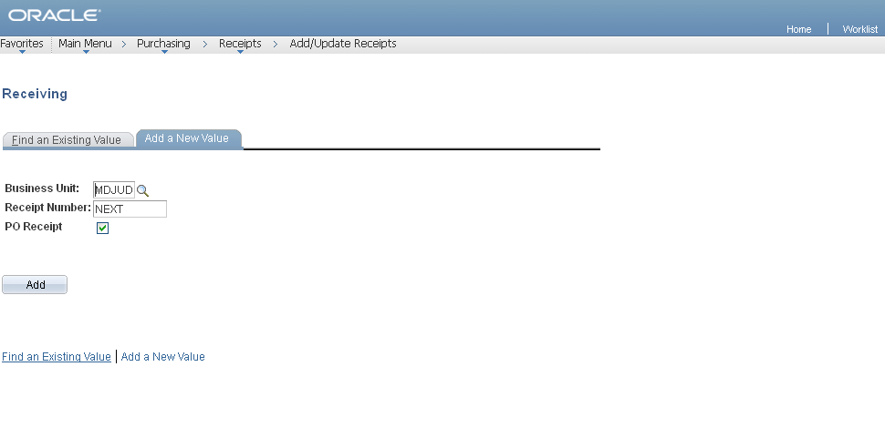
Creating a Receipt – “Receiving” in GEARS

Slide 5
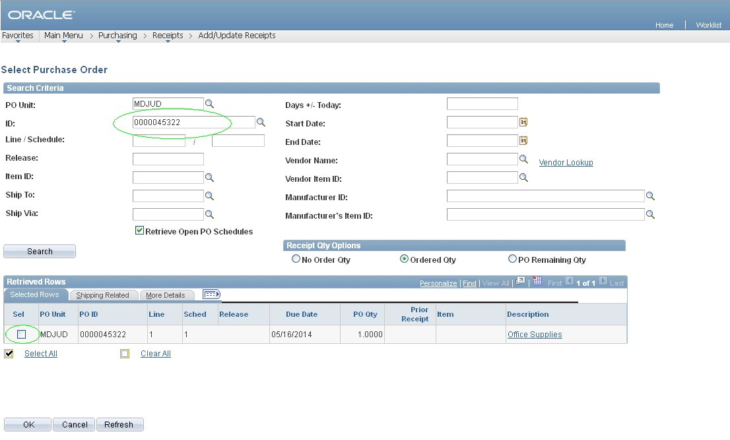
Creating a Receipt – Selecting a PO

Slide 6
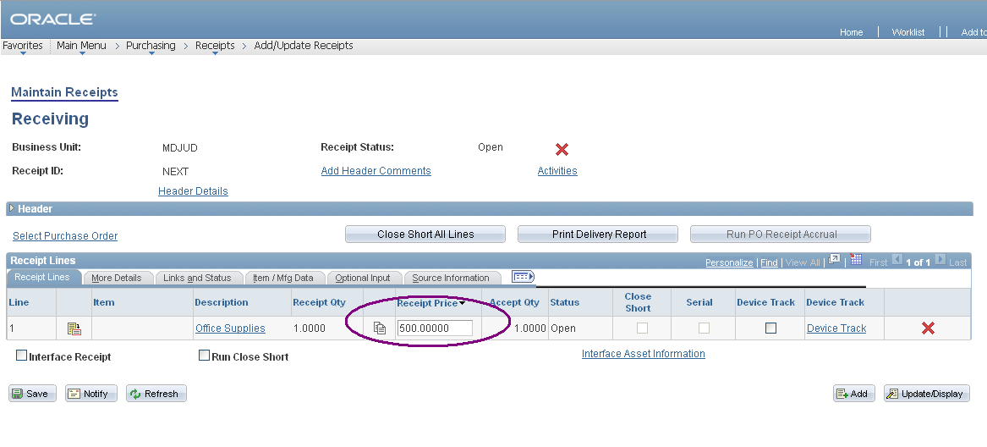
Creating a Receipt – How to Receive Partially

Slide 7
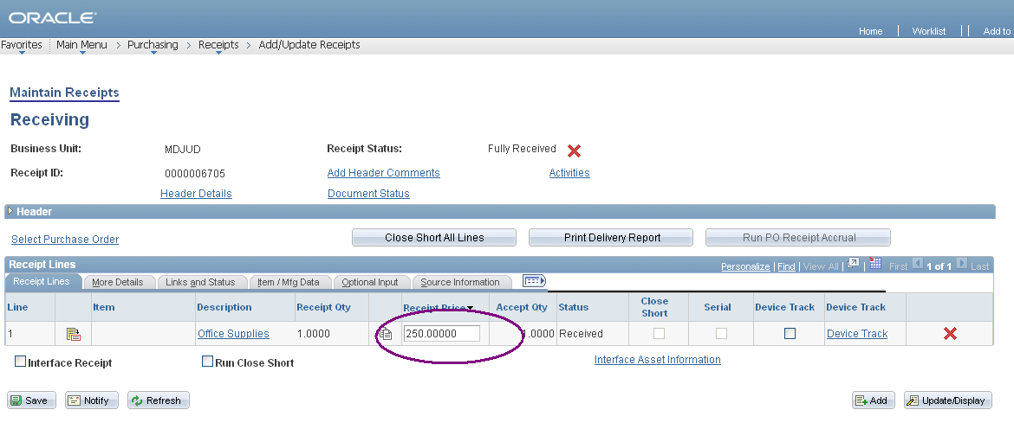
Creating a Receipt- Amount Only Adjustment

Slide 8
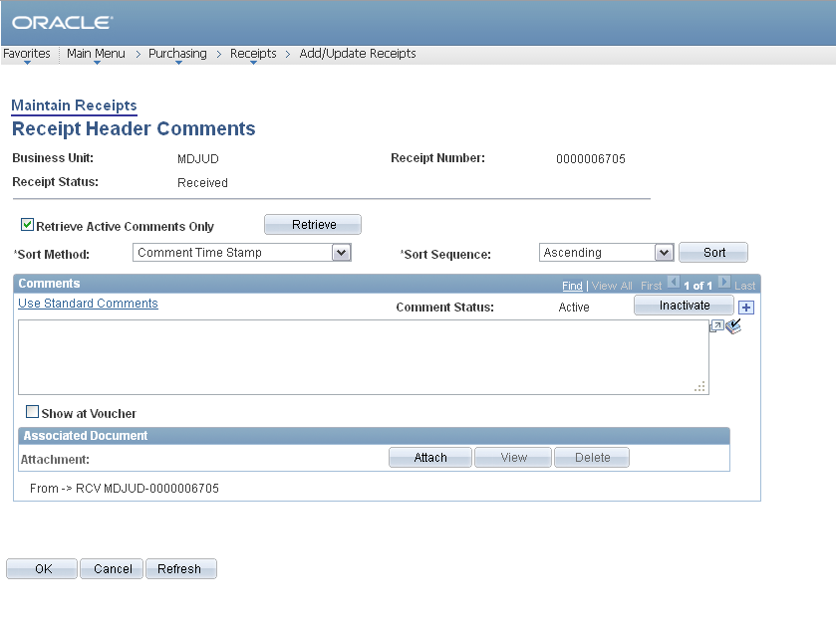
Creating a Receipt – Adding Header Comments & Attachments (packing slip)

Slide 9
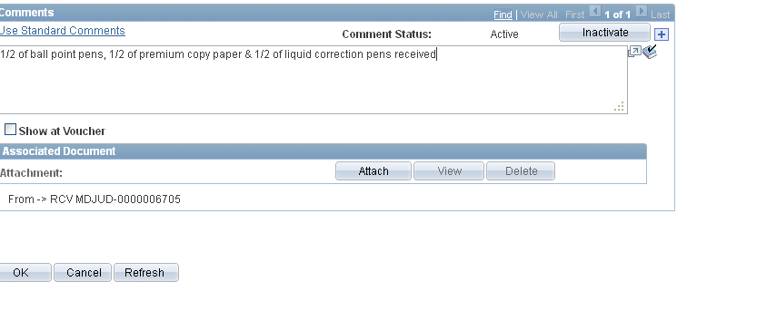
Creating a Receipt- Adding Header Comments

Slide 10
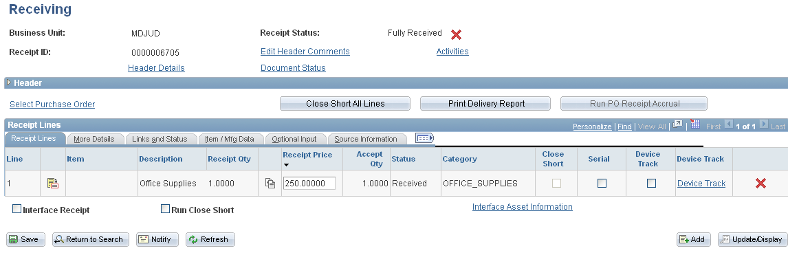
Creating a Receipt- Save and Receipt ID

Slide 11
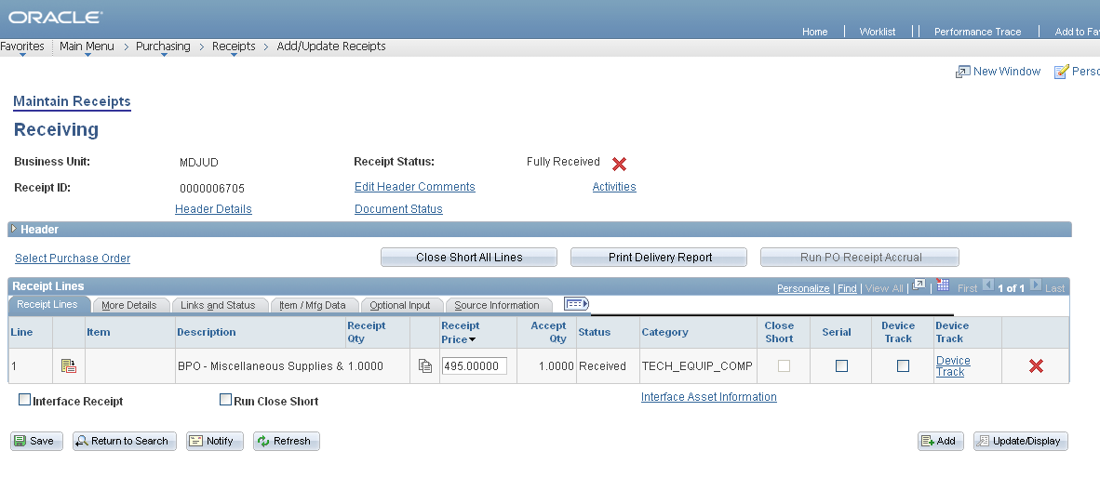
Creating a Receipt – Notifying DCHQ Finance

Slide 12
Also, if the item receives a bar code
Notify the Warehouse at the same time by copying
WarehouseDC@mdcourts.gov.

Slide 13
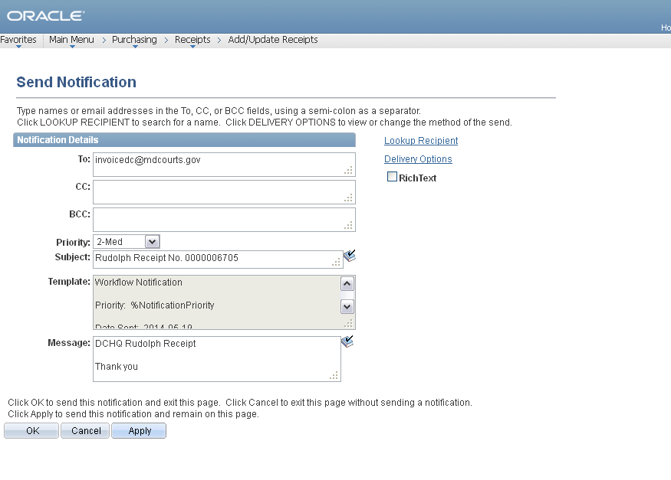
Creating a Receipt – Send Notification
In the subject line, please add the Vendor, P.O. number, and receipt number.

Slide 14
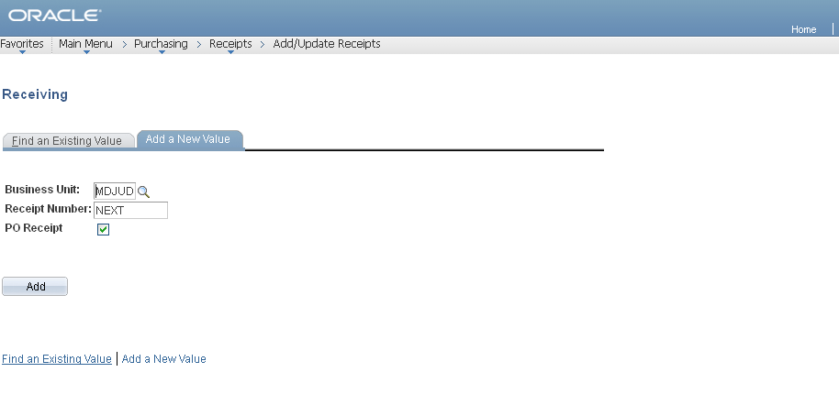
Creating a Receipt – Receiving in GEARS

Slide 15
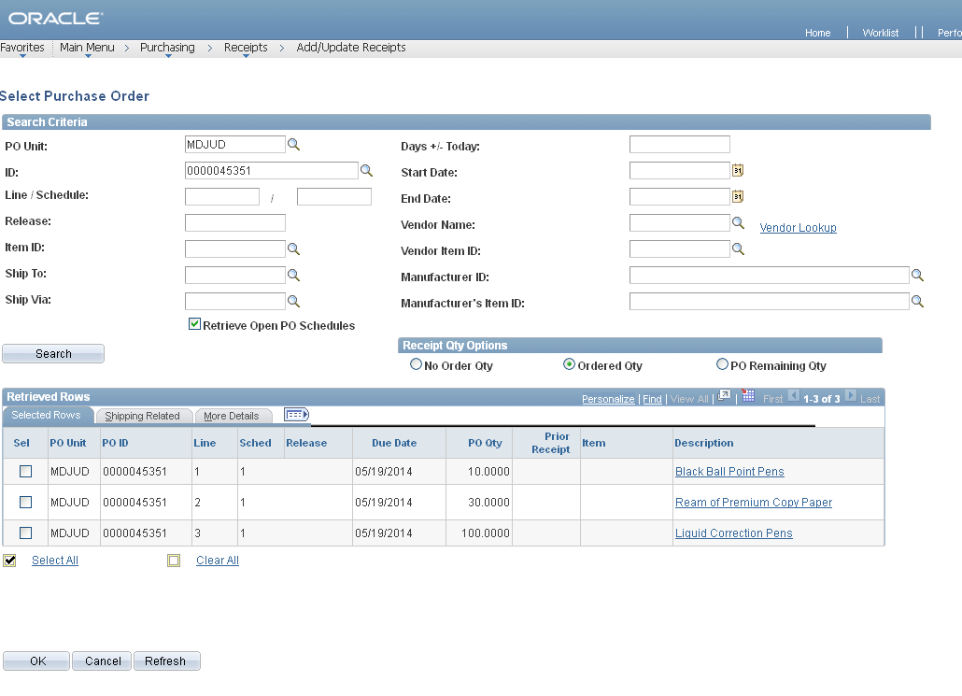
Creating a Receipt – Selecting a PO

Slide 16
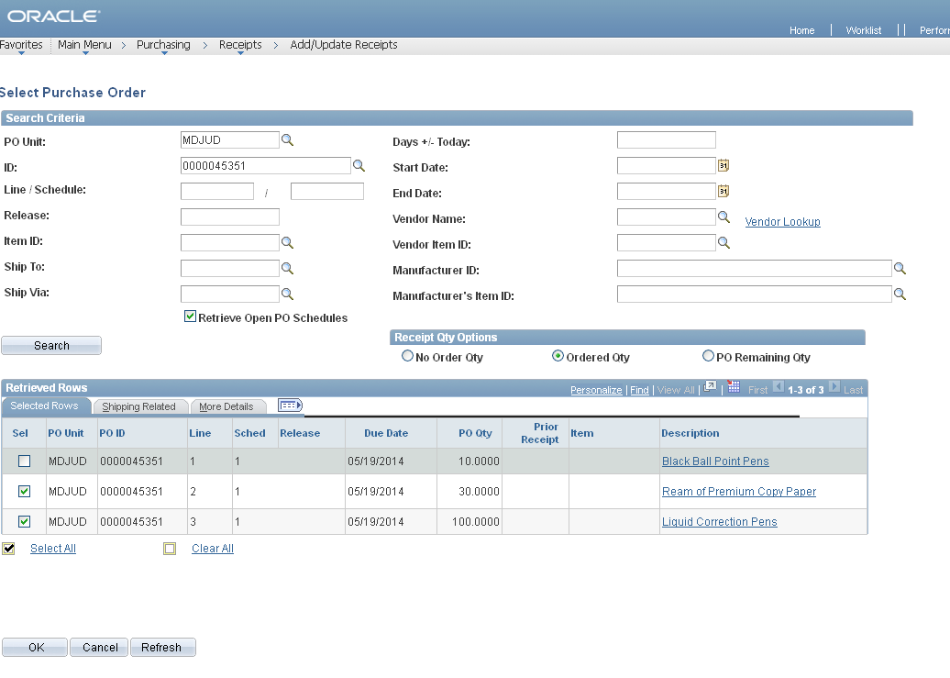
Creating a Receipt – How to Receive Partially

Slide 17
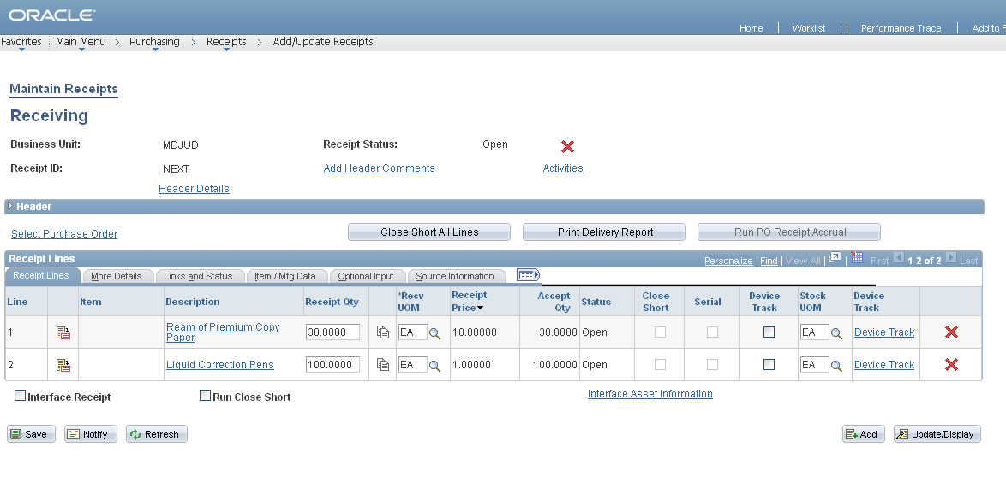
Creating a Receipt – Bringing in Selected Lines

Slide 18
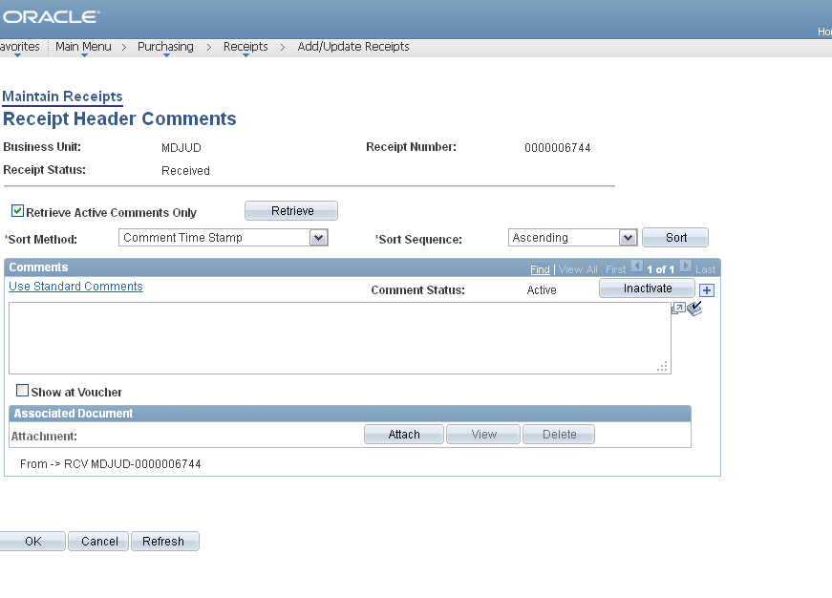
Creating a Receipt – Header Comments & Attachments

Slide 19
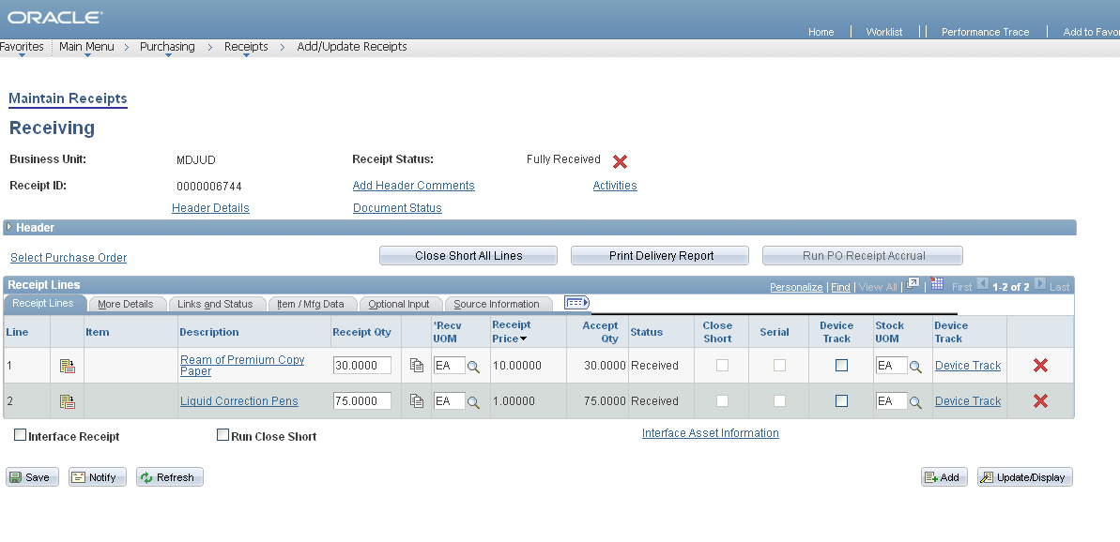
Creating a Receipt – Save and Receipt ID

Slide 20
Creating a Receipt – Notifying DCHQ Finance

Slide 21
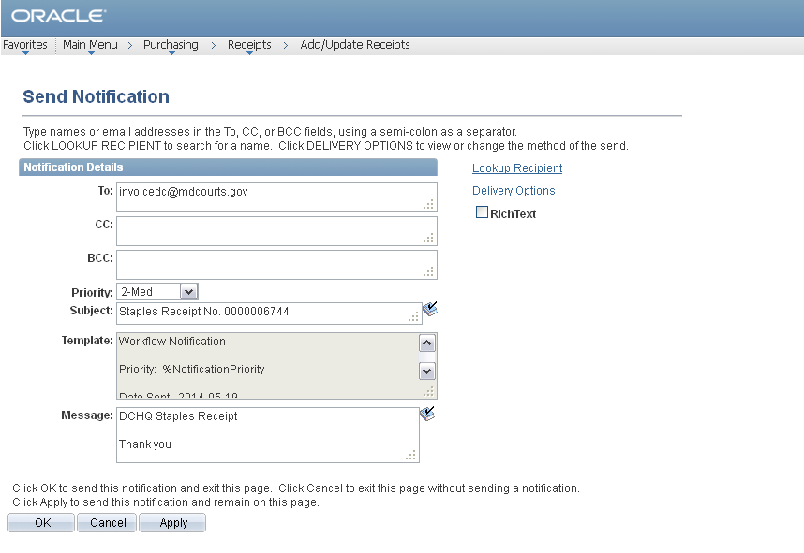
Creating a Receipt – Send Notification
In the subject line, please add the Vendor, P.O. number, and receipt number.

Slide 22
Questions???

Slide 23

GEARS
General Enterprise And Resource Support
Entering
Interpreter Invoices

Slide 24
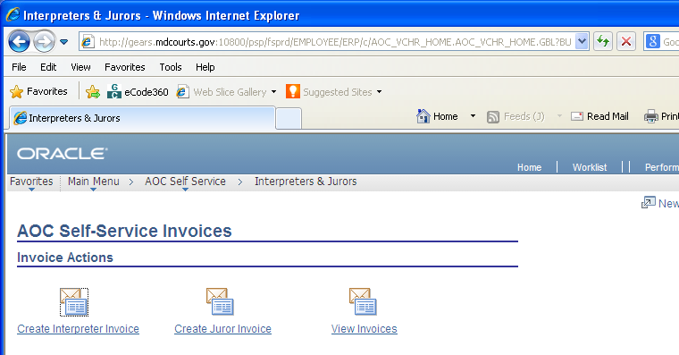
Pathway: Main Menu – AOC Self Service – Interpreters & Jurors

Slide 25
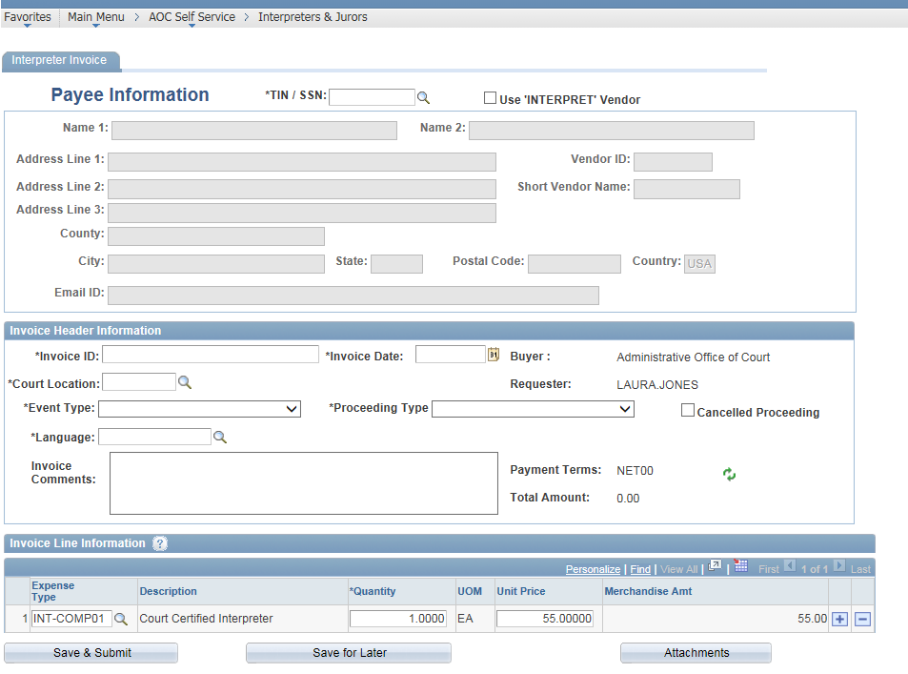
There are three sections: Interpreter Invoice, Invoice Header Information, and Invoice Line Information

Slide 26
For the Interpreter Invoice section:
If the Payee is already set up as a Vendor in the system, enter the TIN/SSN or by searching using the Look Up TIN/SSN search.
NOTE: The TIN or SSN must be 9 digits.
The Payee’s information (name, address, Vendor ID) will auto-populate.
NOTE: The name and address fields cannot be edited as this information is populated by what is on the Vendor table in the system.

Slide 27
For the Interpreter Invoice section:
If the Payee is NOT already set up as a Vendor in the system, click the Use “INTERPRET” Vendor checkbox. The *TIN/SSN AND Vendor ID fields will auto-populate with ‘INTERPRET’.
NOTE: Leave the Payee Information blank. The Department of Budget and Finance (DBF) or District Court Headquarters (DCHQ) will update the Payee Information after the Voucher Build, once the vendor has been added to the system.

Slide 28
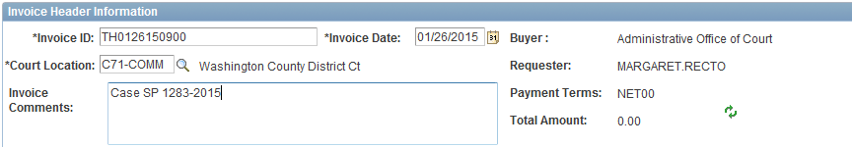
The following information must be entered under the “Invoice Header Information” tab:
Invoice ID – Formatted as follows: XXMMDDYYxxxx (interpreter’s initials, date of assignment, start time) i.e. TH0126150900.
Invoice Date
(must match Invoice date
on the hard copy invoice)
Court Location – this applies to the court where services are being performed.
Invoice Comments – optional

Slide 29
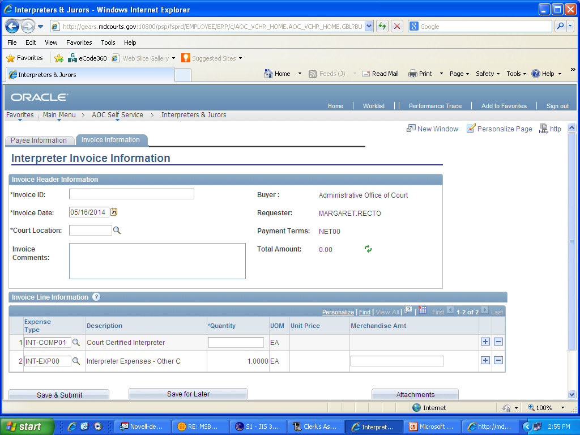
The Buyer, Requester, and Payment Terms fields are populated by the system based on your user ID settings.
The Total Amount field will change based on the amount entered in the Invoice Line Information section of the page.

Slide 30
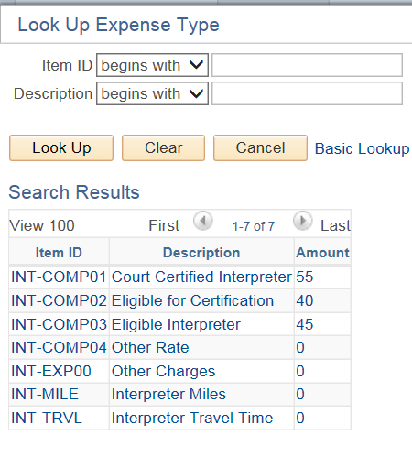
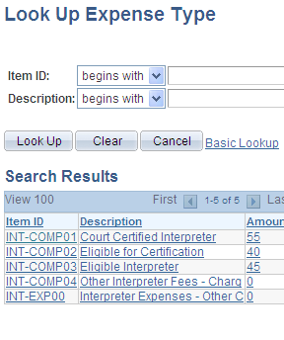
For the Invoice Line Information section:
To enter the line information for an Interpreter Invoice, please enter the amount of hours that the Interpreter has logged into the Quantity field on line 1 (Expense/Interpreter Type: INT-COMP01).
Click the magnifying glass to change the expense type:
Use INTCOMP04 - Other Interpreter Fees only when you are paying a rate not shown.

Slide 31
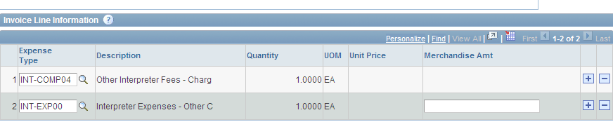
To add a line use the +/- on the side of each invoice line.

Slide 32

Click on the “Attachment” button to attach the interpreter’s completed invoice and Rand McNally driving directions.
The “Attachment” button will change to the following when a document has been attached:

Slide 33
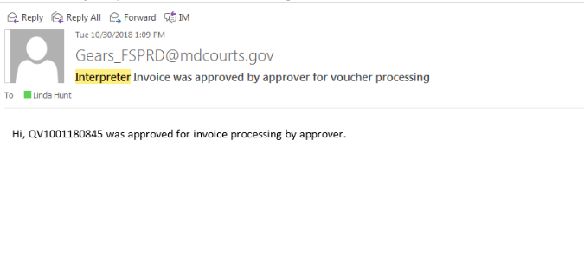
Click “Save and Submit” and a screen will appear that states the invoice was submitted successfully.
An email notification will be sent upon the approval of the invoice.

Slide 34
Questions???

Slide 35
GEARS
General Enterprise And Resource Support
Using
Quick Invoices
for
Expense Accounts
And
Appointed Attorney Invoices

Slide 36
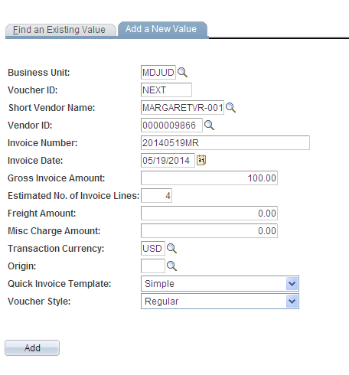
Pathway: Main Menu – Accounts Payable – Vouchers – Add/Update – Quick Invoice
Short Vendor Name / Vendor ID – If this information is available, please enter it.
Invoice Number – Formatted as follows: For Expense Account: yyyymmddXX,
i.e. 20150501SA;
For Appointed Attorney: ATTmmddyyyyXX,
i.e.ATT05012015SA
Invoice Date – Date the invoice is being entered. (Or the invoice date listed on the Appointed Attorney Invoice)
Gross Invoice Amount – Total invoice amount.

Slide 37
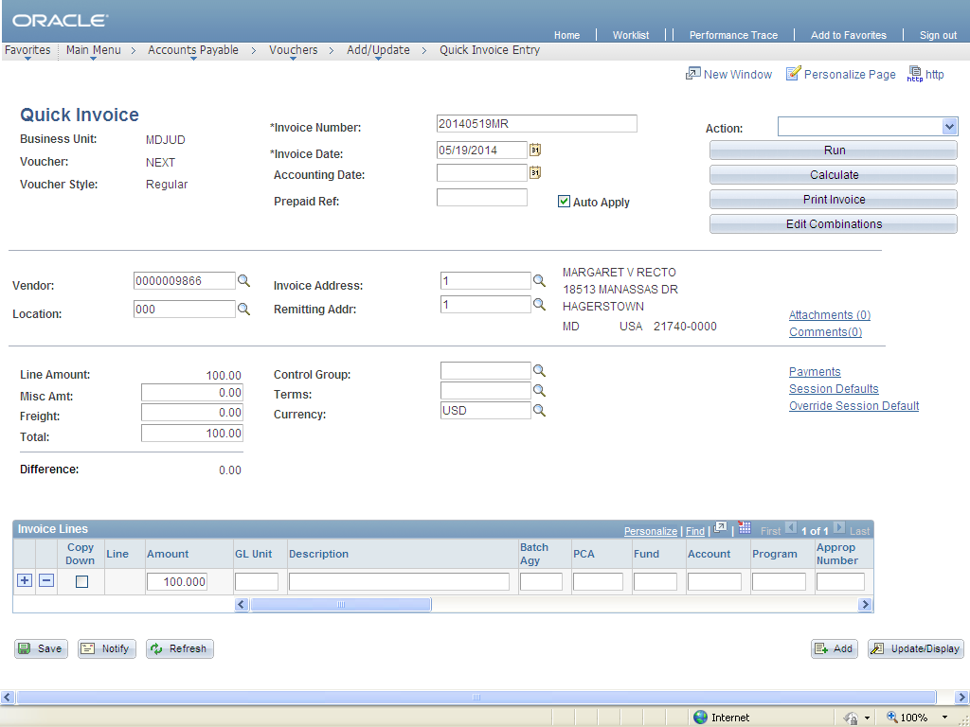
After clicking “Add” on the first page, the information will populate on the next screen. Add your attachments and comments here:

Slide 38
Attachments: Attach the expense report or AA invoice and appropriate receipts.
Comments: Entered by and phone number
New Employees: Follow the same steps without entering vendor information and note “New employee – please assign vendor ID” on the expense report.

Slide 39
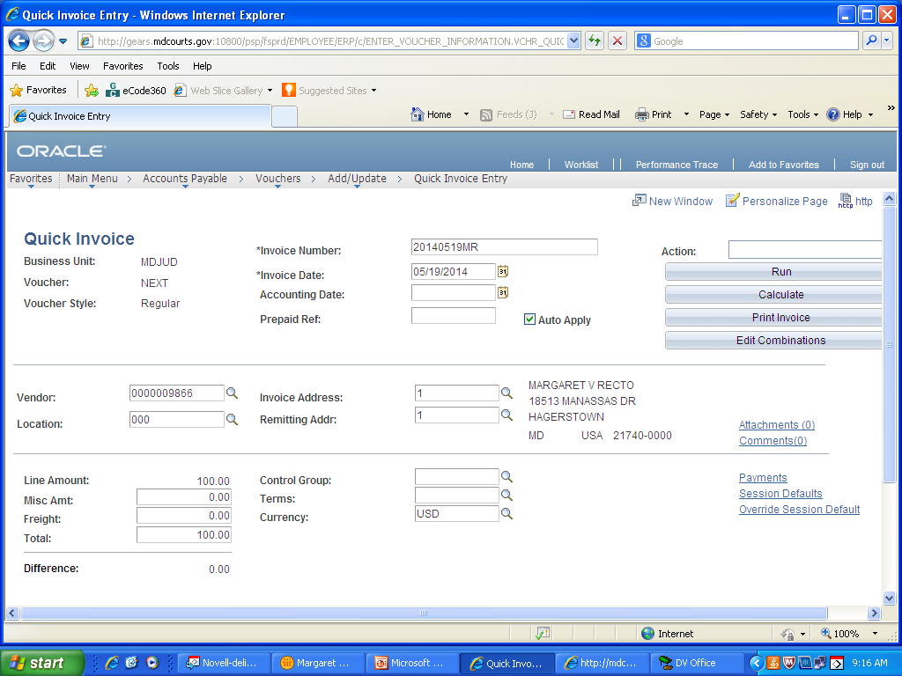
Click “Save” to submit the quick entry voucher
A voucher number will be assigned upon completion.
0000081506

Slide 40
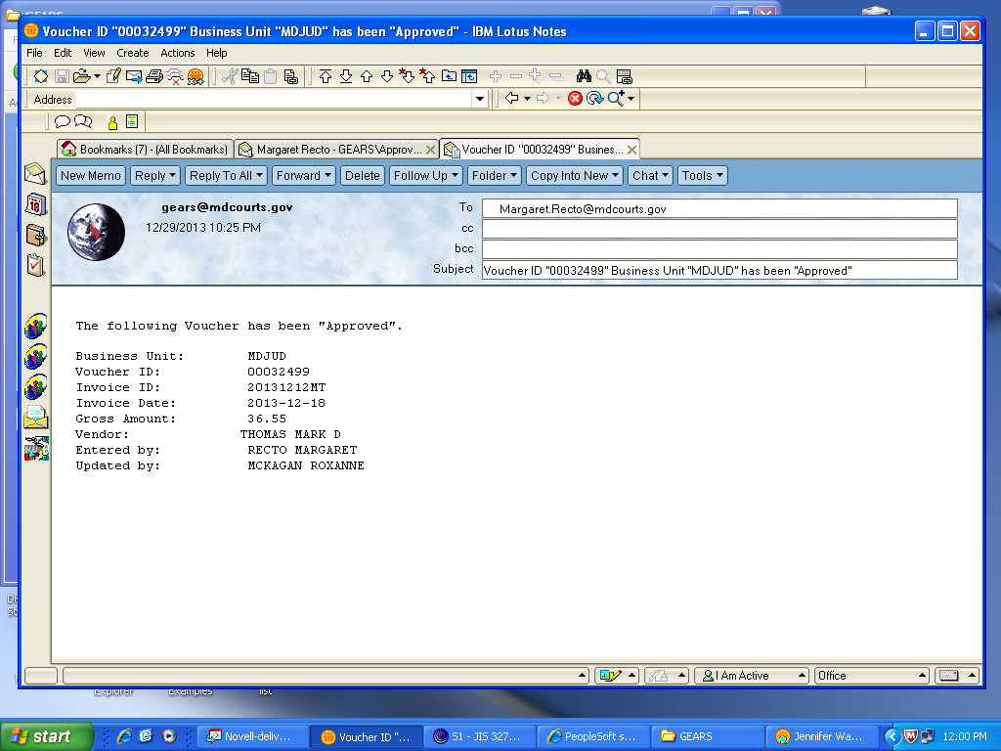
An email notification will be sent once the voucher is approved.

Slide 41
Questions???

